Slide 1


Just in Time Training
Measles Response
Johanna Bossé
Vaccine Preventable Disease Epidemiologist
August 1, 2025
Online

Slide 2
Objectives
Discuss measles presentation and transmission
Review isolation and quarantine guidelines
Describe levels of immunity and prevention measures
Review post-exposure prophylaxis
Discuss testing for suspect cases
Review high level processes of case investigation
Discuss contact tracing focusing on large scale tracing

Slide 3
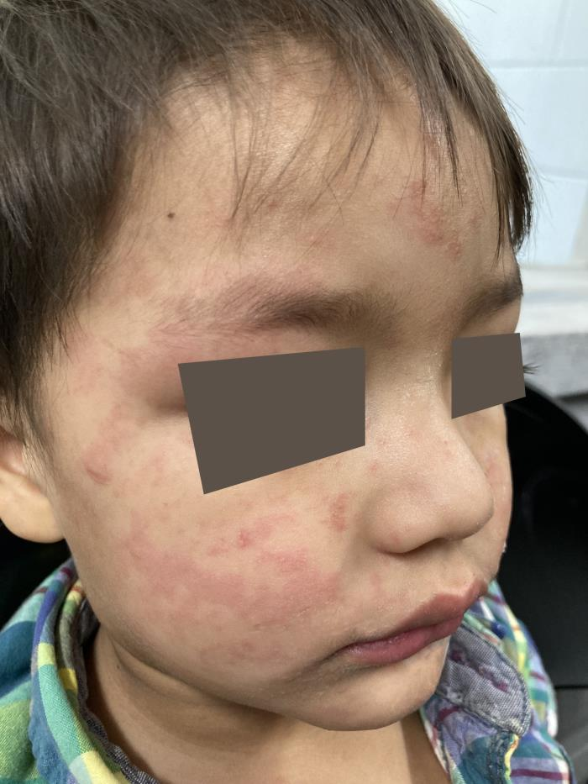
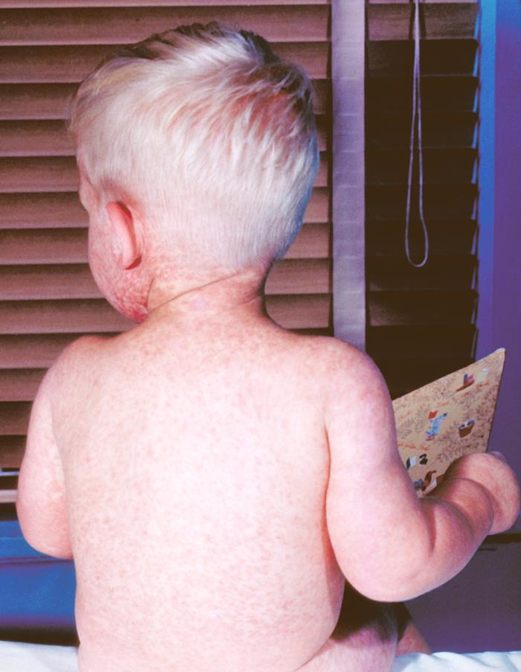
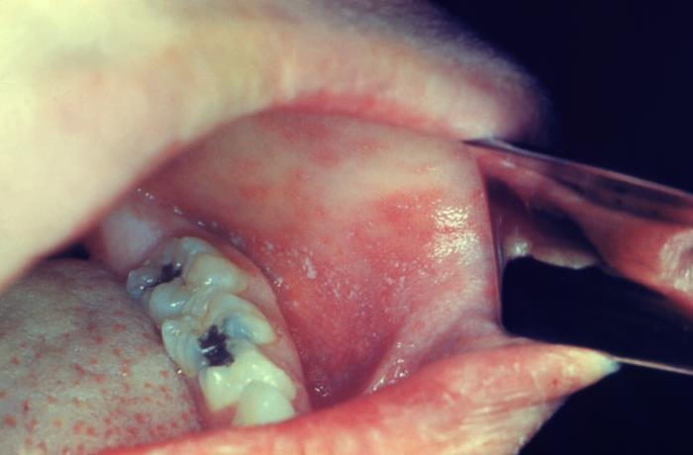
Is it Measles?
Measles Progression
Incubation period (10 to14 days)
                No visible symptoms
Prodromal Period (two to four days)
Fever
Three C’s (cough, coryza, and conjunctivitis)
Koplik spots
Rash (three to five days after prodromal period)
Starts on face and upper neck and spreads downward
Recovery
  Rash fades in the same order it appeared
  No longer contagious once the rash has disappeared

Slide 4
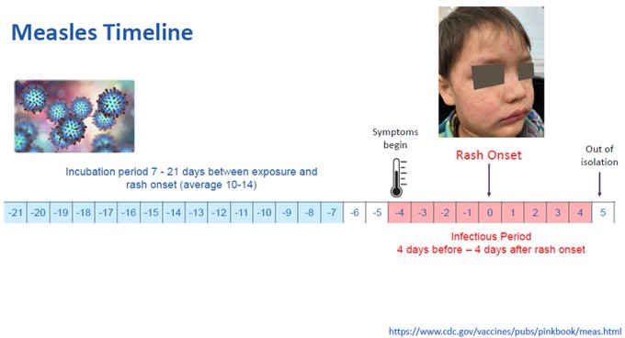
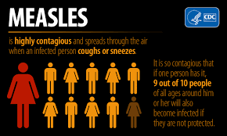
How is it spread?
The virus is transmitted by:
Direct contact with infectious droplets
Airborne spread when an infected person breathes, coughs, or sneezes
Measles virus can remain infectious in the air for up to two hours after an infected person leaves an area

Slide 5
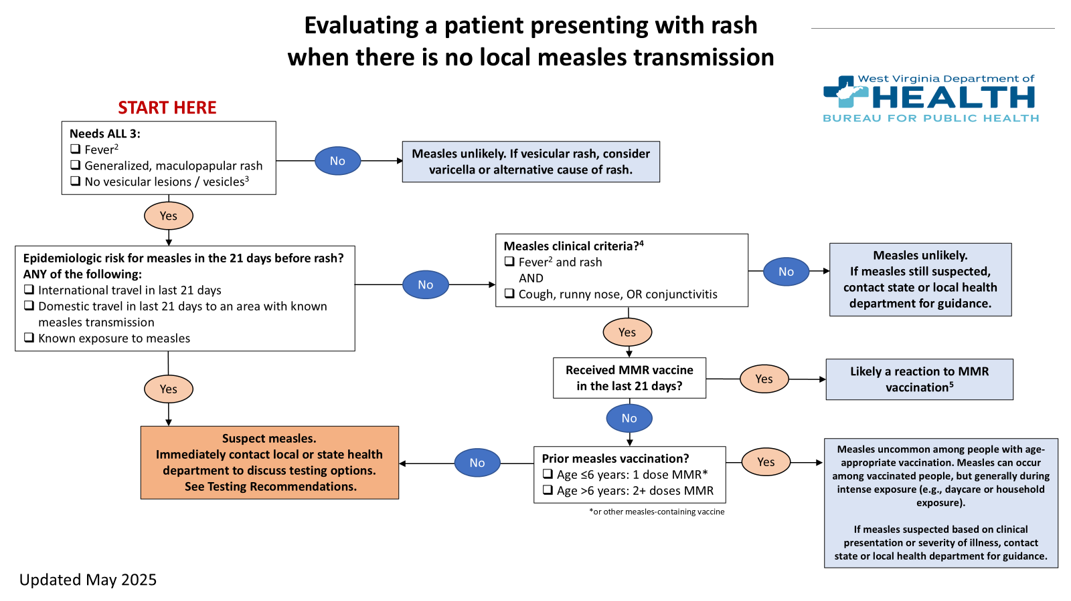
Is Measles suspected?

Slide 6
Determining Measles Risk
Clinical Compatibility:
Fever
AND maculopapular rash (non-vesicular)
AND at least one of the “Cs” (cough, coryza, and/or conjunctivitis)
Susceptibility:
No documented MMR vaccinations
No positive IgG titer
Not born before 1957
No documentation of previous infections
Exposure Risk (in past 21 days):
International travel
Domestic travel to an area with known measles transmission
Contact with a suspected or confirmed case

Slide 7
Risk of Measles Low
ONE or fewer:
Clinically compatible illness
Confirmed or likely exposure
Susceptible to measles
Testing Recommendation:
Not recommended, providers may choose to test commercially if desired
Local Health Department (LHD) Recommendations:
Consider alternative diagnosis
Public Health does not need to follow up

Slide 8
Risk of Measles Moderate
Meets:
Clinically compatible illness
AND one from below:
Confirmed or likely exposure
Susceptible to measles or unknown immune status
Testing Recommendation:
Consider testing consult with Office of Epidemiology and Prevention Services (OEPS)
LHD Recommendations:
Provide isolation instructions
Contact tracing investigation may wait until test results

Slide 9
Risk of Measles High
Meets all three:
Clinically compatible illness
Confirmed or likely exposure
Susceptible to measles
Testing Recommendation:
Urgent testing, contact OEPS immediately
LHD Recommendations:
Notify OEPS
Initiate full measles investigation
Ensure case isolation
Begin contact investigation
Assess Post-Exposure Prophylaxis (PEP) needs

Slide 10
Isolation Guidance
If you suspect your patient has measles or was exposed to measles:
Patients with measles or suspected measles should call ahead so healthcare facilities can limit additional exposures
Isolate your patient with suspected measles immediately
  Ideally in a single patient airborne infection isolation room or in a private room with closed door
People exposed to measles who do not have evidence of immunity may be eligible for post-exposure prophylaxis
People who are infected should be isolated for four days after they develop a rash
Airborne precautions should be followed in healthcare settings

Slide 11
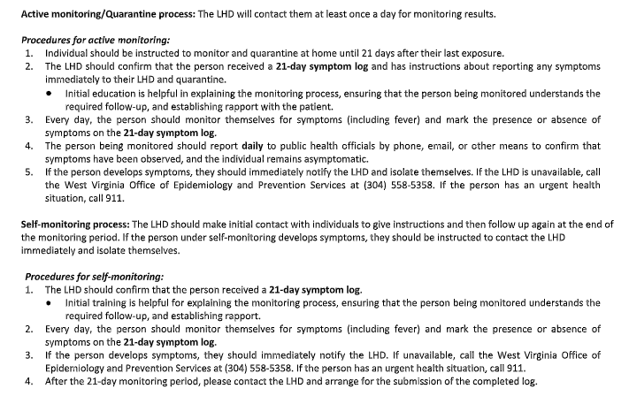
Quarantine Guidance
Active monitoring/quarantine is recommended for anyone who does not have documentation of immunity. Self-monitoring can be done for those who do have documentation of immunity.

Slide 12
Evidence of Immunity
Acceptable presumptive evidence of measles immunity includes at least one of the following:
Written documentation of adequate vaccination; or
Laboratory evidence of immunity; or
Birth before 1957; or
Laboratory confirmation of disease
Persons who do not meet the above criteria are considered susceptible and should be vaccinated unless contraindicated

Slide 13
Post-Exposure Prophylaxis
People exposed to measles who cannot readily show that they have adequate presumptive evidence of immunity against measles should be offered PEP
Public health officials can help identify eligible persons, assess any contraindications, and weigh benefits
There are two types of PEP for measles. To potentially provide protection or modify the clinical course of disease among susceptible persons, administer one of these:
  Measles, Mumps, and Rubella (MMR) vaccine, if administered within 72 hours of initial measles exposure
  Immunoglobulin (IG), if administered within six days of exposure. The recommended dose for intramuscular immunoglobulin (IMIG) is 0.5mL/kg, regardless of the contact’s immune status
Do not administer MMR vaccine and IG simultaneously; this practice invalidates the vaccine

Slide 14
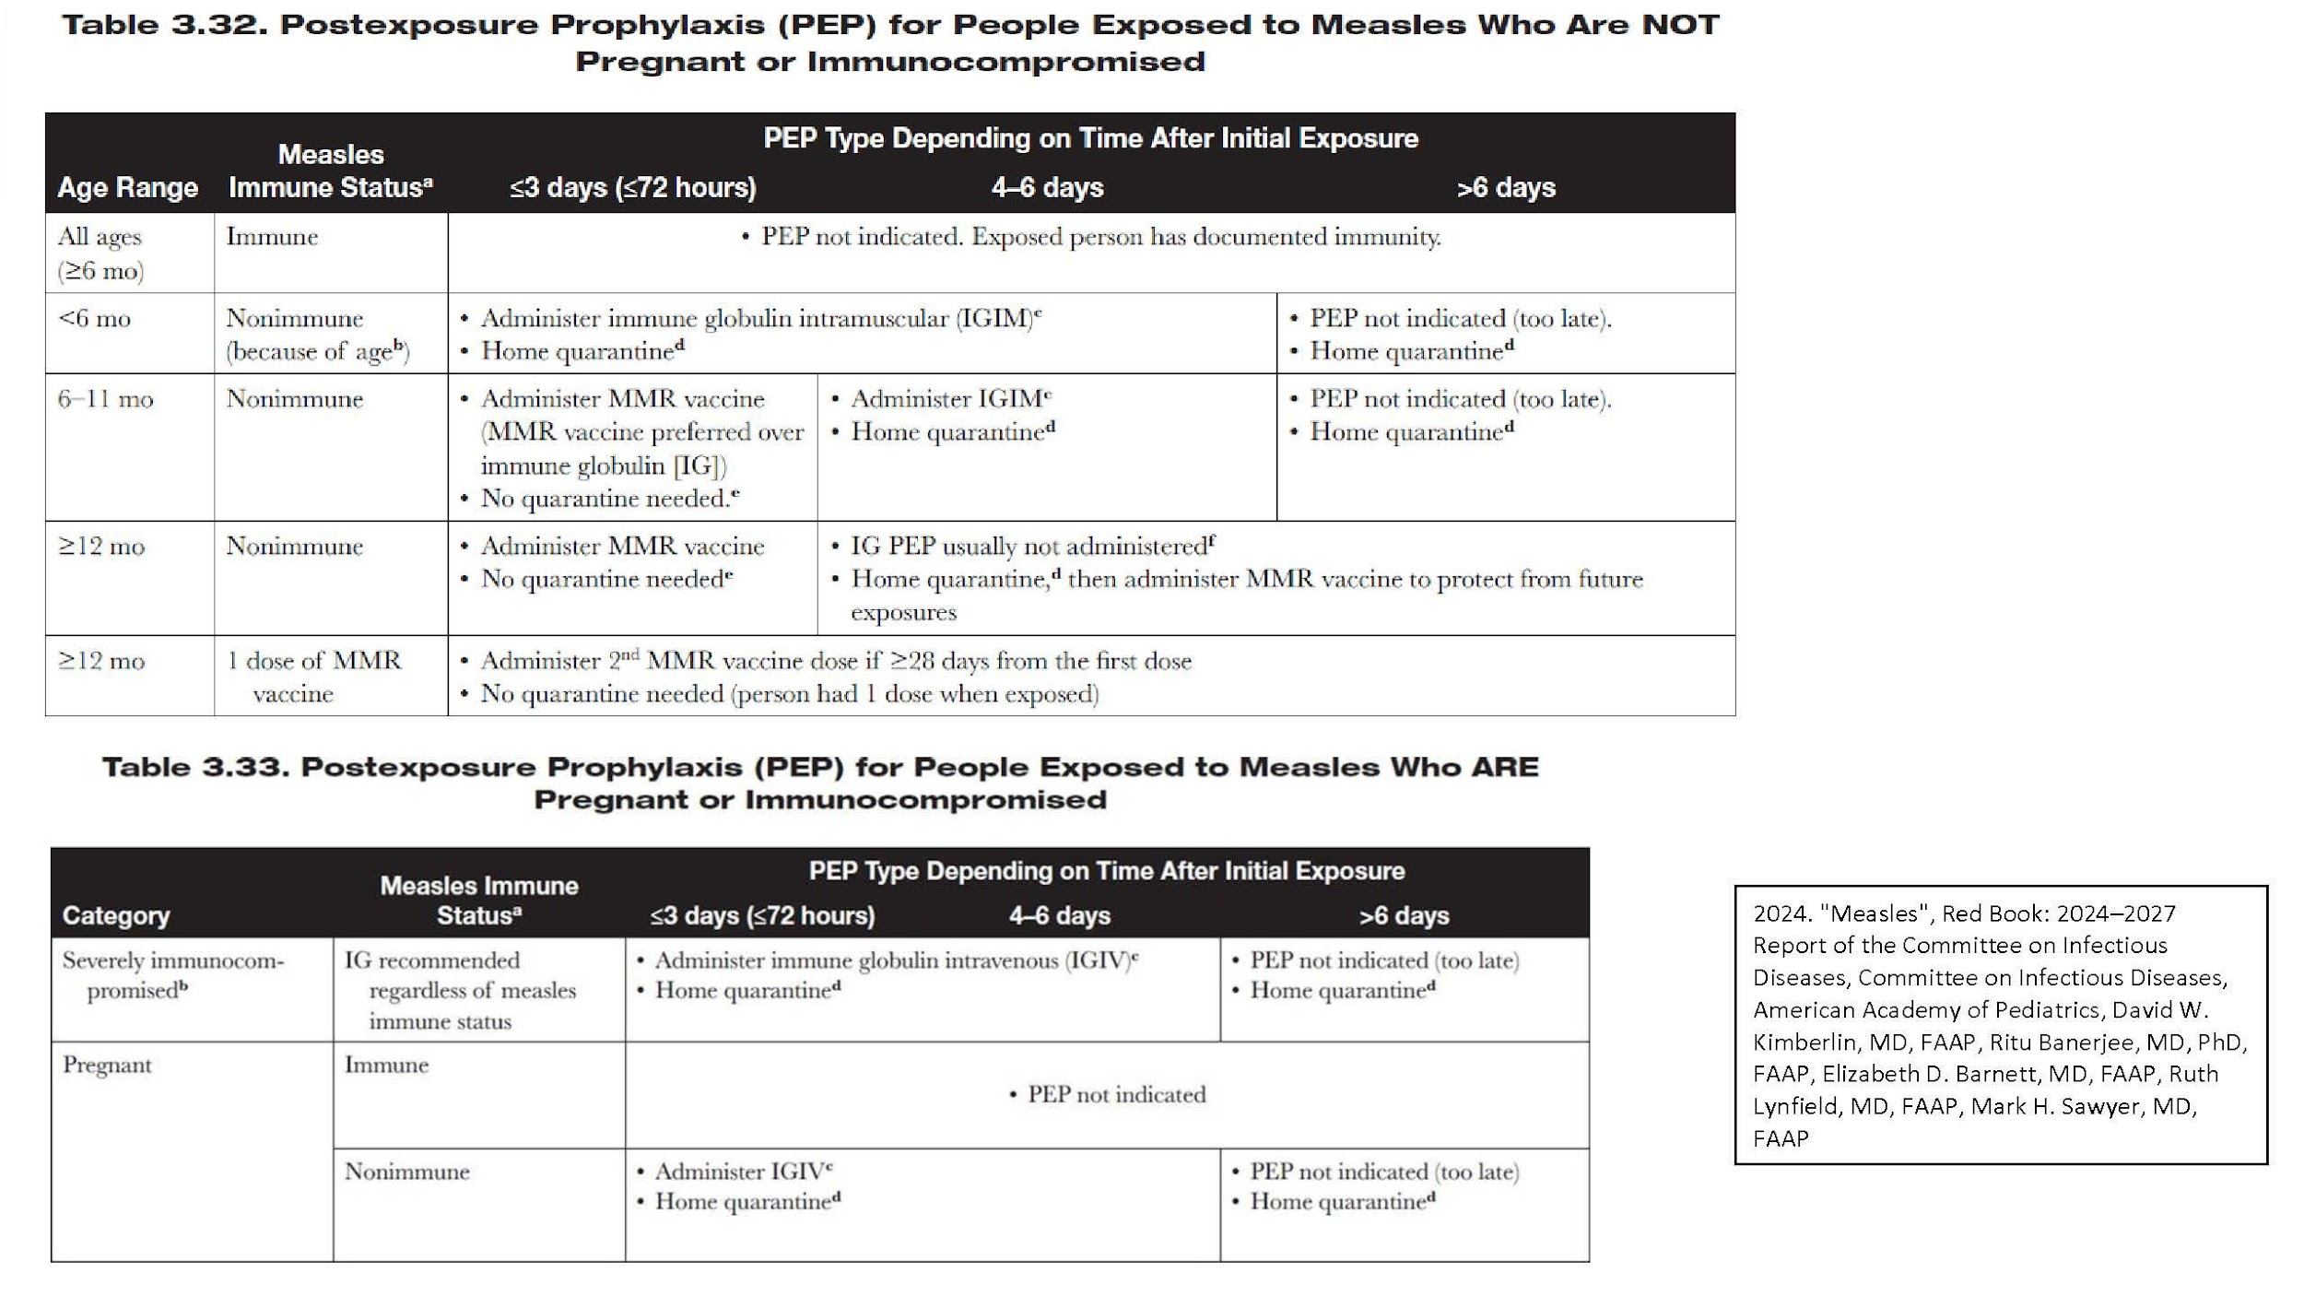
Post-Exposure Prophylaxis

Slide 15
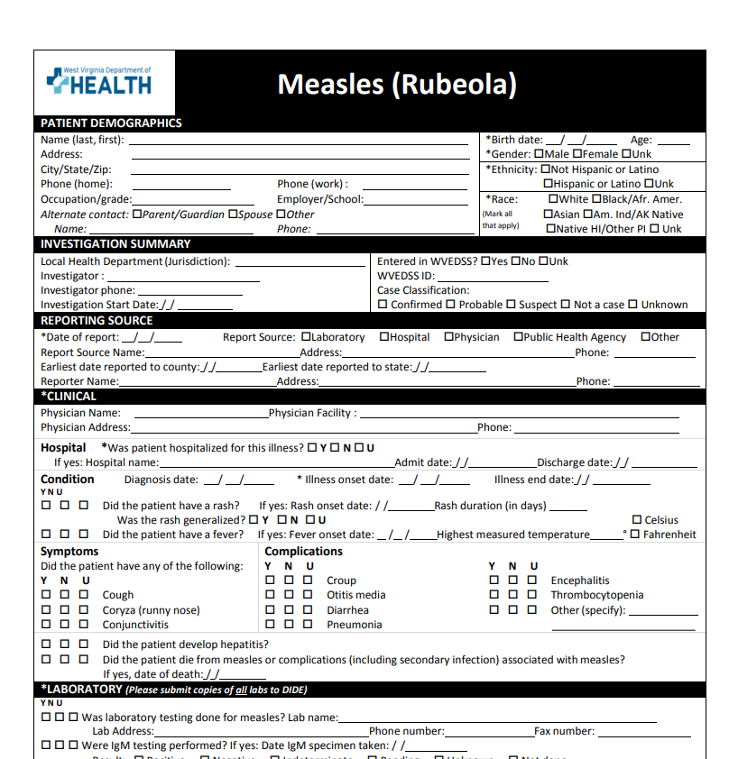
Case Investigation Form

Slide 16
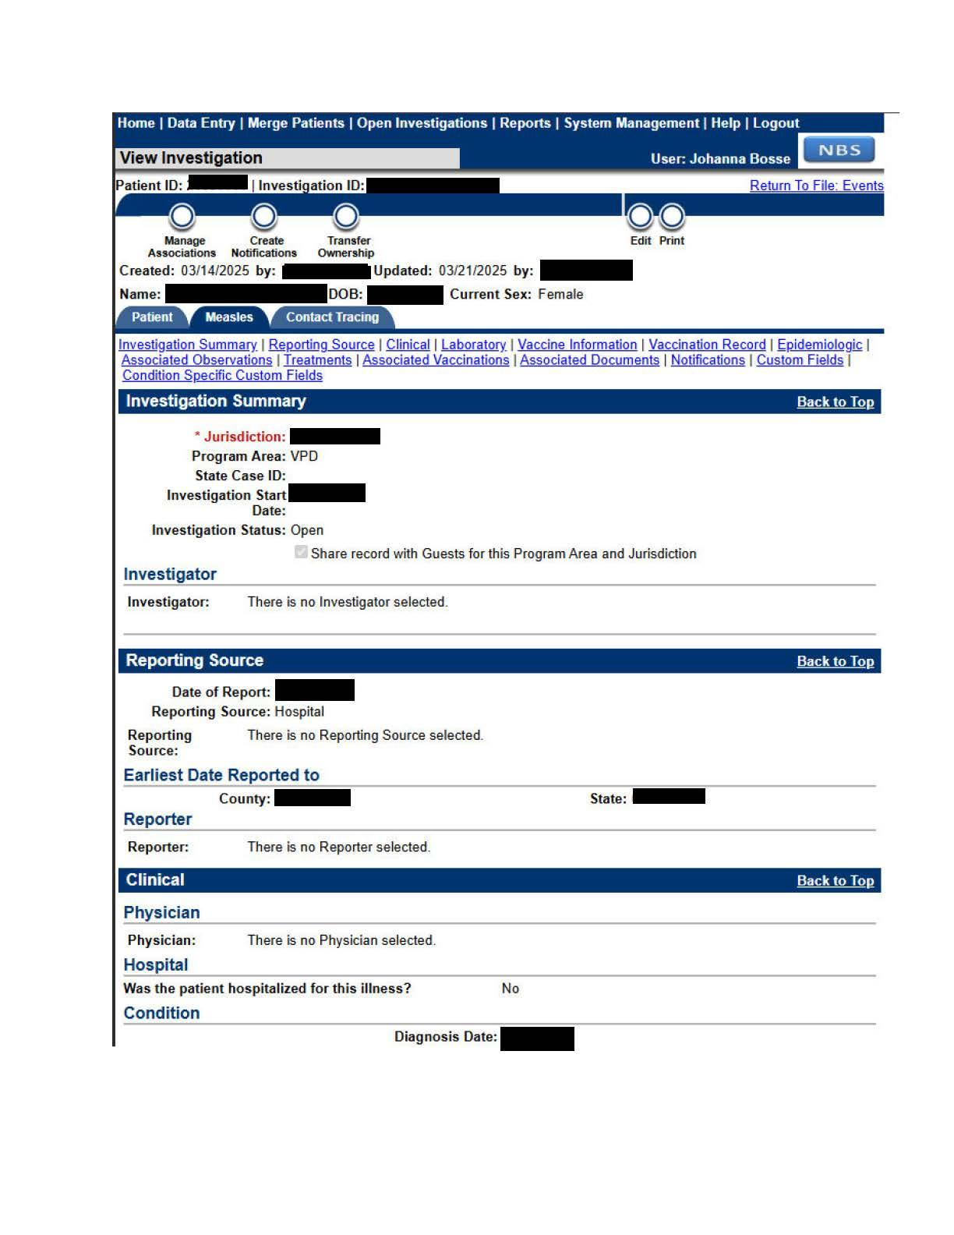
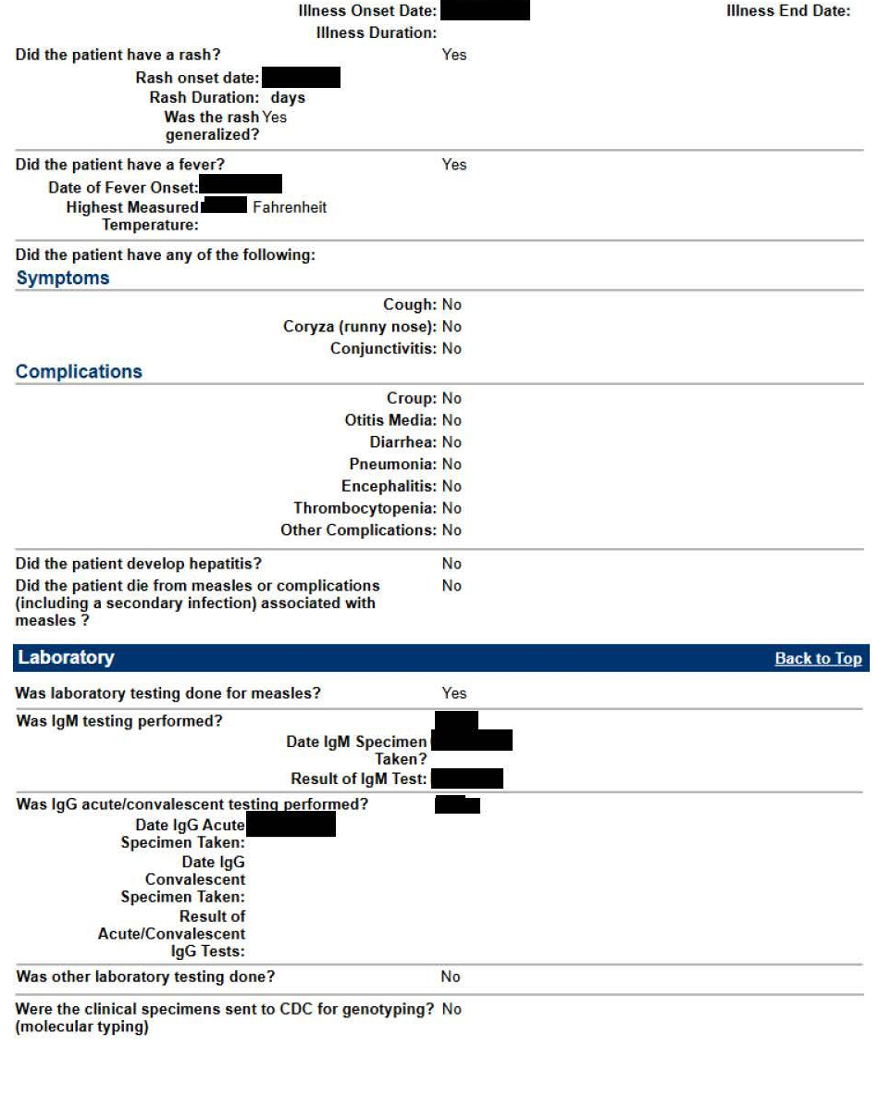
Case Investigation in West Virginia Electronic Disease Surveillance System (WVEDSS)

Slide 17
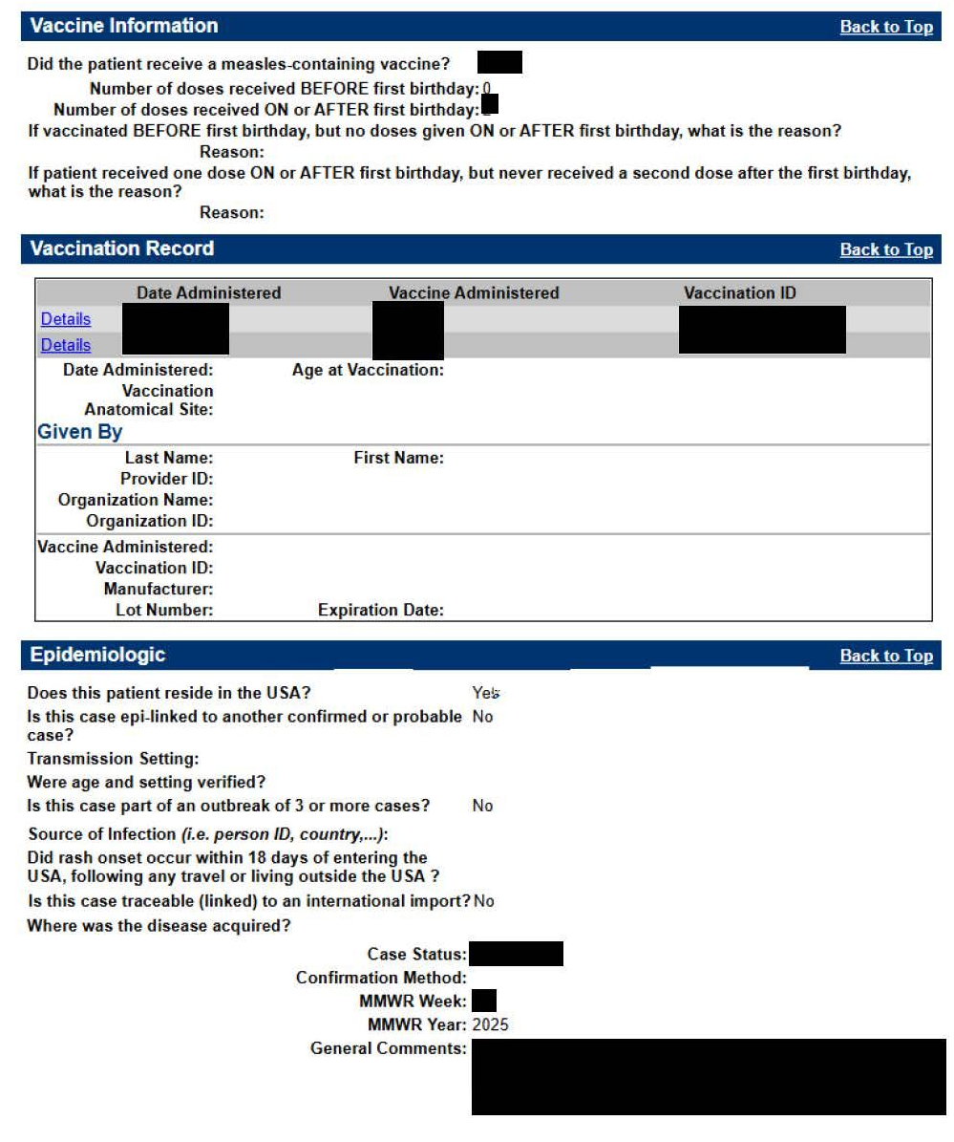
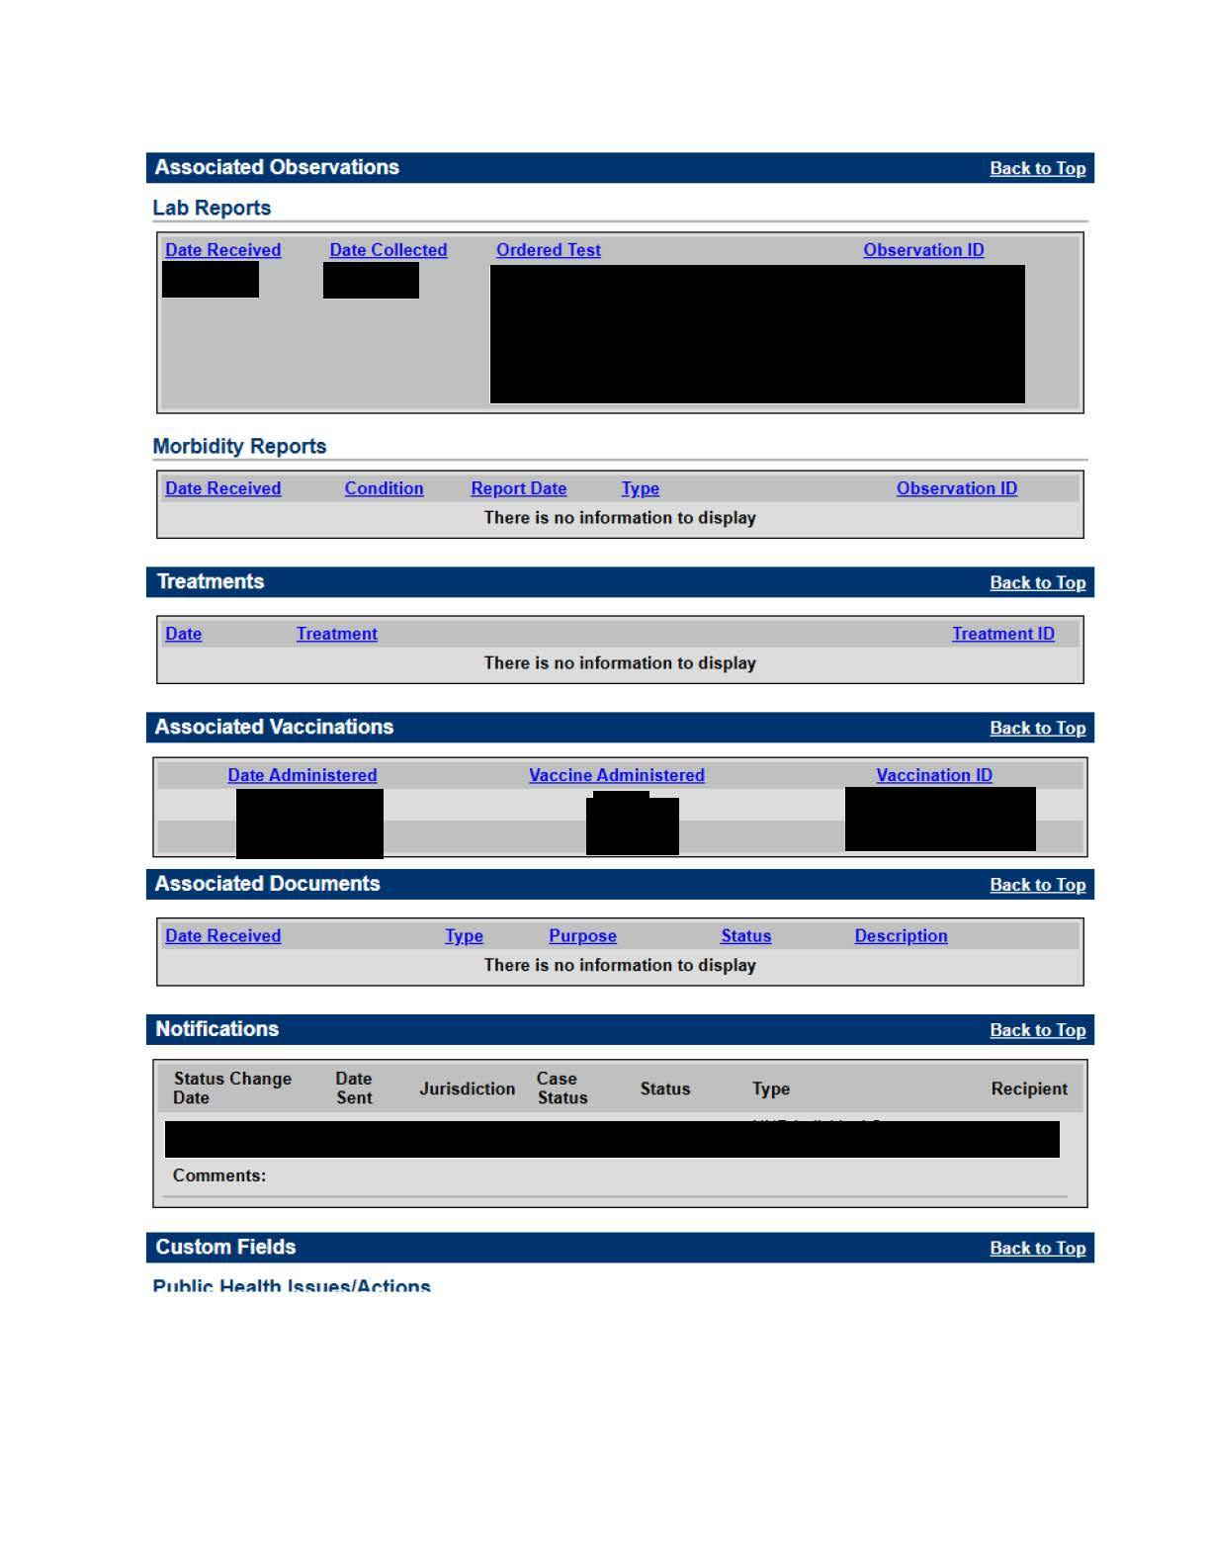
Case Investigation in WVEDSS (cont’d)
Notes:
-This is an example of a case investigation in EDSS. Highlight some of the important information collected.

Slide 18
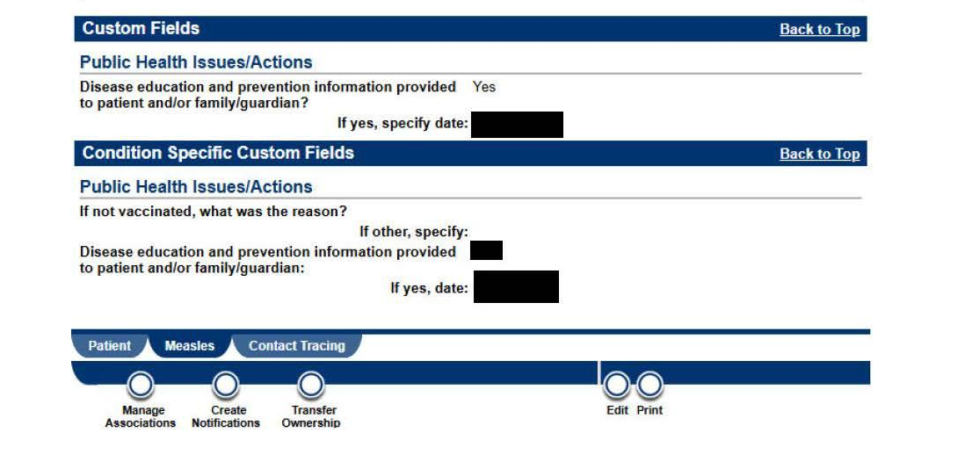
Case Investigation in WVEDSS (cont’d)
Notes:
-Mention there is an area within WVEDSS where you can keep track of contacts that were discovered during contact tracing activities

Slide 19
Contact Tracing
Timely contact tracing is imperative to stop an outbreak
Finding everyone who comes into direct or indirect contact with a measles patient.
  A close contact would include individuals in areas where an infected person was for up to two hours after they leave
  Contacts are watched for signs of illness for 21 days from the last day they came into contact with the measles patient
LHD should contact case patients to determine all locations they may have been during their infectious period. This may include working with healthcare facilities to gather lists of patients potentially exposed
If patient was outside of their jurisdiction, this information must be shared with the other jurisdiction immediately
LHDs will need to contact all exposed individuals to inform them of the exposure. This will require determining vaccination status to determine if individual needs PEP, if they will need to be quarantined, or if they can self monitor

Slide 20
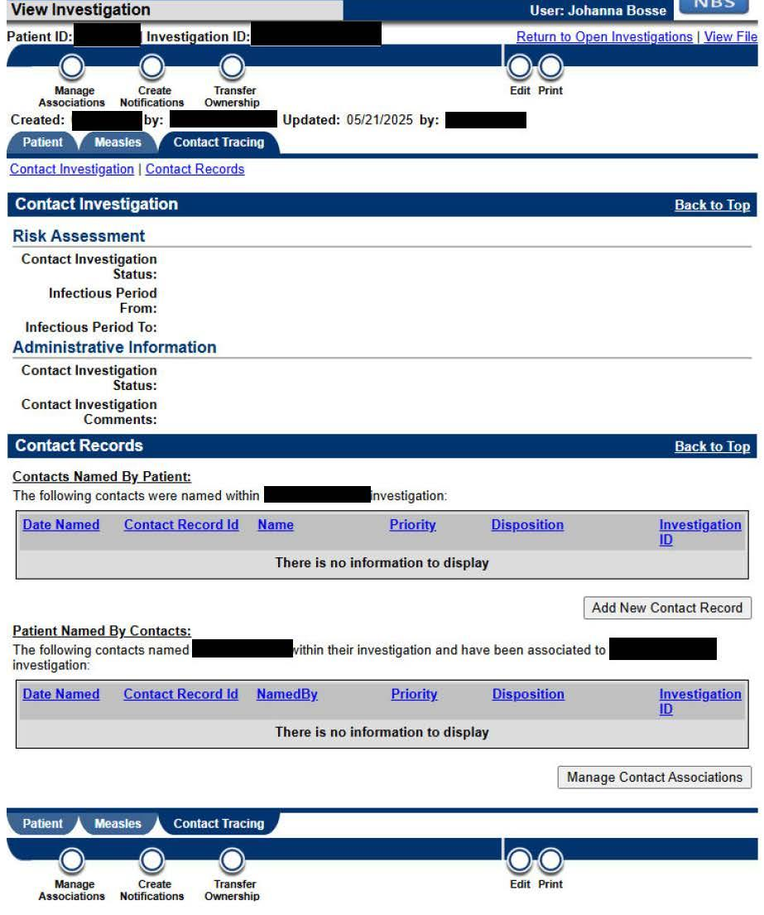
Contact Tracing in WVEDSS

Slide 21
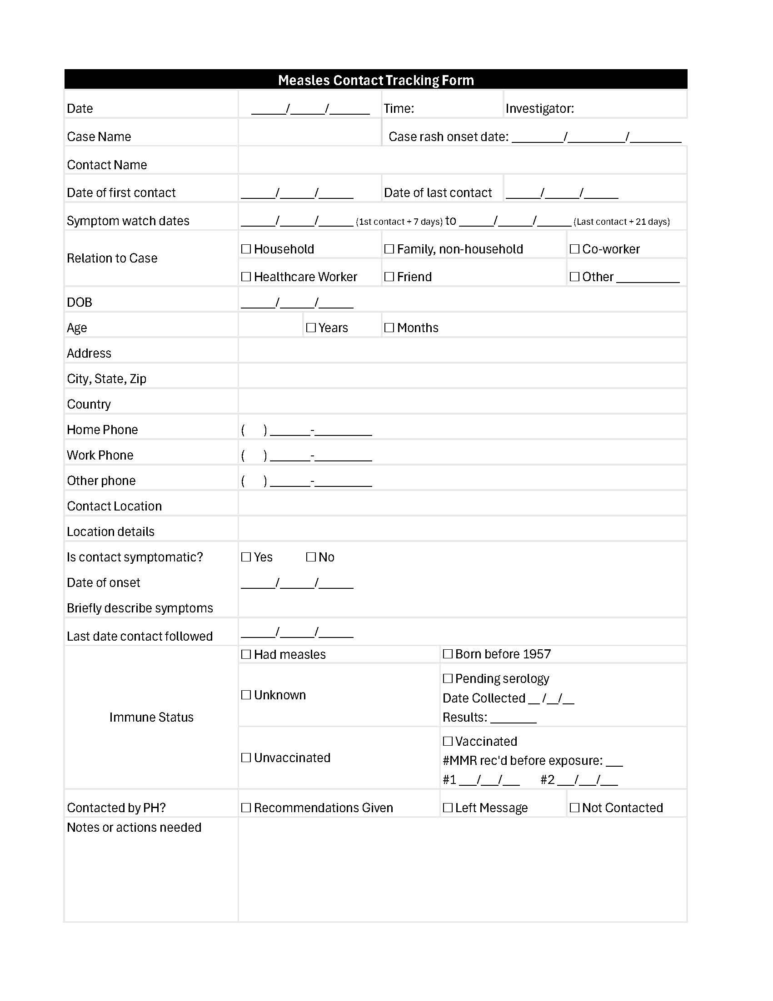
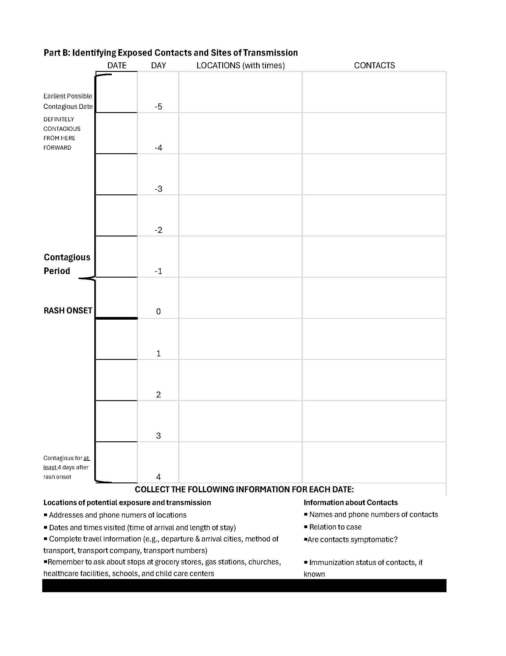
Contact Tracing Form

Slide 22
Contact Tracing (cont’d)
This could be an extensive process
LHDs may need to obtain volunteers for contact tracing
Request assistance from the state
Activate medical reserve corps or other trusted public health partner within the community

Slide 23
Assessing Contact Risk
Low-Risk Contacts and Settings vs High-Risk Contacts and Settings
A low-risk contact is a person who is not at high risk of experiencing severe measles illness, or the transmission potential is not high
A low-risk setting is one in which transmission risk is low and multiple high-risk contacts are not present
A high-risk contact is a person who may experience severe illness if they become infected with measles or to whom the transmission potential is high
A high-risk setting is one in which transmission risk is high or where there are multiple high-risk contacts, particularly persons who could experience severe disease if infected with measles

Slide 24
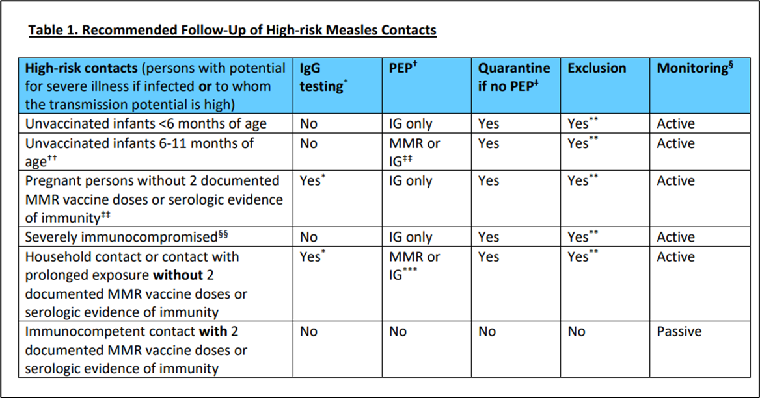
Follow-up of High-Risk Measles Contacts

Slide 25
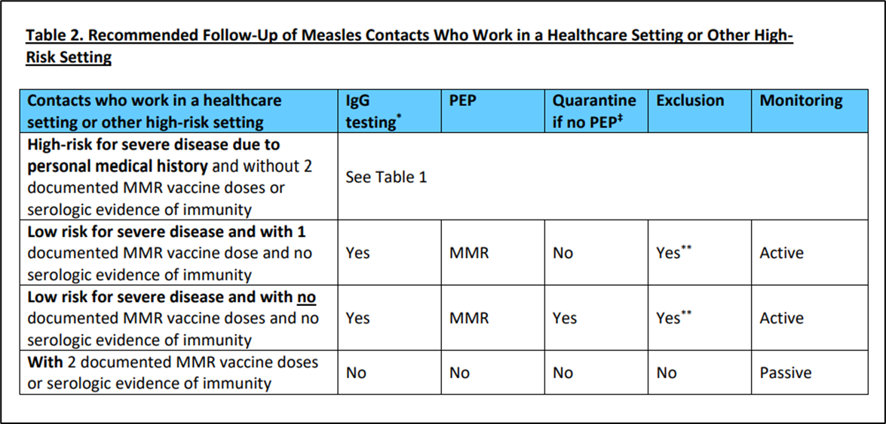
Follow-up of Measles Contacts in Healthcare or Other High-Risk Settings

Slide 26
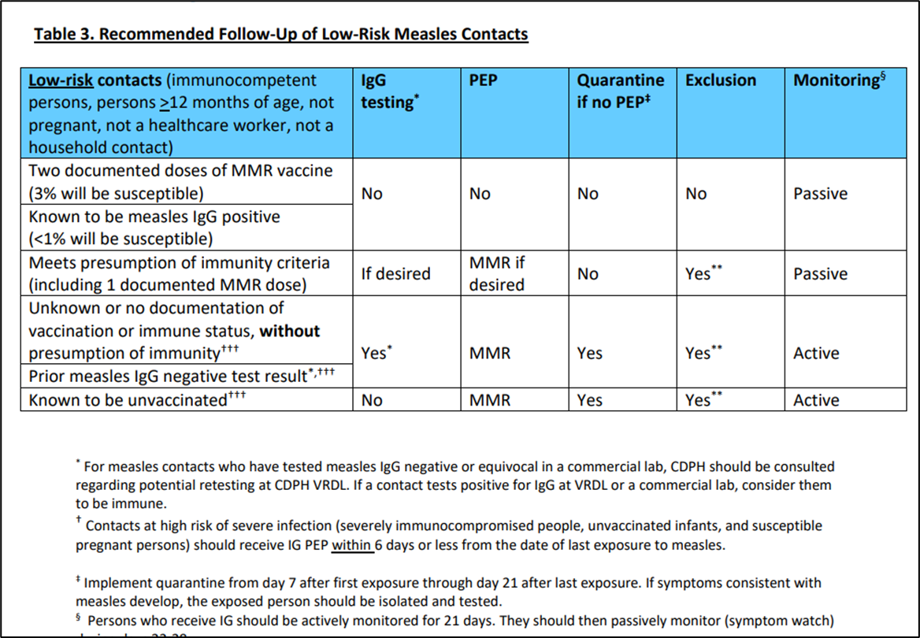
Follow-up of Low-Risk Measles Contacts

Slide 27
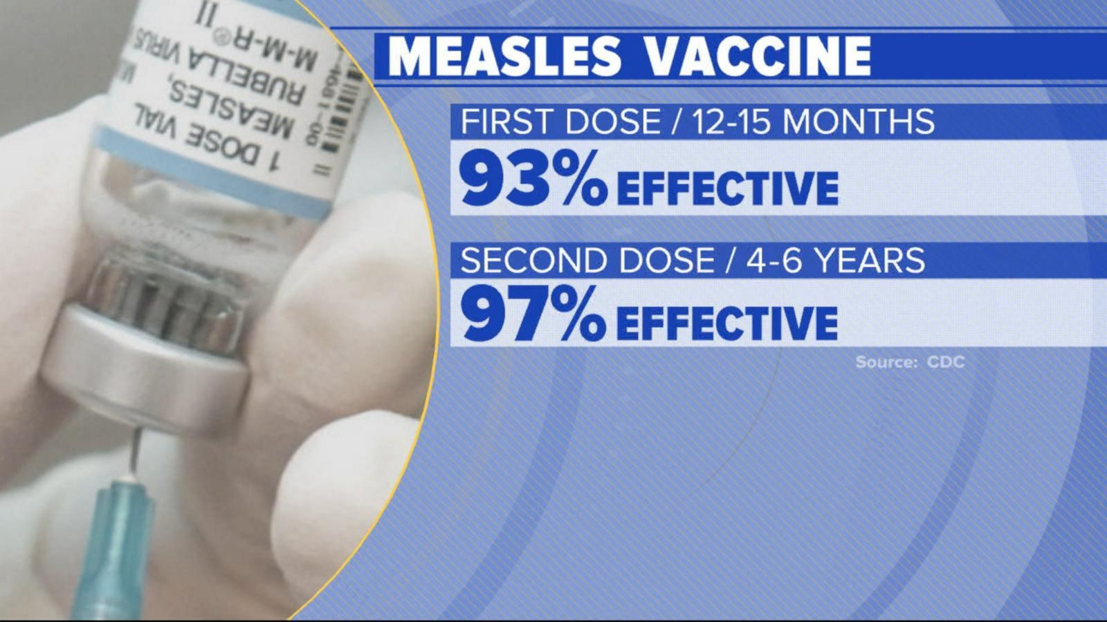
Prevention Measures

Slide 28
Contact Information
Johanna Bossé
Vaccine Preventable Disease Epidemiologist III
West Virginia Department of Health
Bureau for Public Health
Office of Epidemiology and Prevention Services
Immunization Services Division
500 Summers Street, Floor 2
Charleston, WV 25301
Phone: 304-352-6294
Email: Johanna.L.Bosse@wv.gov | oeps.wv.gov

