Slide 1
Influenza A(H3N2)v Detections at the Jackson County Junior Fair 2022
Jillian Wall, MPH
Respiratory Disease Epidemiologist Influenza Surveillance Coordinator 2023 West Virginia Immunization Summit
June 9, 2023
Notes:
Good afternoon,
I’m Jillian Wall, the Respiratory Disease Epidemiologist and today I will be giving a review of the Influenza A(H3N2) variant detections from the Jackson County Junior Fair last summer.

Slide 2
Objectives
Identify the partners involved in an outbreak investigation of Influenza A(H3N2)v during a fair.
Understand the steps taken to control an Influenza A(H3N2)v outbreak.
Understand the recommendations made by public health to the fair board, cases, and contacts.
Notes:
The objectives for this presentation are:

Slide 3
Agencies Involved
Fair Board
Jackson County Local Health Department (LHD)
National Veterinary Services Laboratory
Centers for Disease Control and Prevention (CDC)
West Virginia Department of Health and Human Resources (DHHR), Office of Epidemiology and Prevention Services (OEPS)
DHHR, West Virginia Office of Laboratory Services (WV OLS)
West Virginia Department of Agriculture (WVDA)
Notes:
Many animal and human health agencies were involved in the response effort. The Fair Board, West Virginia Department of Agriculture, and National Veterinary Services Laboratory were focused on response efforts for the ill swine. The Jackson County Local Health Department, OEPS, OLS and CDC were all involved in the response effort for persons that became ill following attendance at the fair.

Slide 4
Outbreak Timeline
Swine illness
reported to the
Fair Board
Swine illness reported to LHD
CDC drafts IHR
and Epi-X notifications
Health Advisory distributed
Swine barn closed
Human and swine viral sequences show >99.9% identity match
CDC notification of a suspected novel influenza case
Jackson County Junior Fair
July 25
July 26
July 27
July 28
July 29
July 30
July 31
Aug 1
Aug 2
Aug 3
Aug 4
Aug 5
Aug 6
Aug 7
Aug 8
Aug 9
LHD
Ill fairgoer,
tests influenza-
Case 1 reported
Case 2 reported
Case 3 reported
WVDA
Swine test
influenza A+
Swine test
influenza
A(H3N2)+
Case 1
RIDT
Flu A+
Presumptive +
Confirmed
Influenza A(H3N2)v
Illness
Onset
Recovery
Case 2
RIDT
Flu A+
Presumptive +
Confirmed
Influenza A(H3N2)v
Illness
Onset
Recovery
Case 3
RIDT
Flu A+
Presumptive +
Confirmed
Influenza A(H3N2)v
Illness
Onset
Recovery
Notes:
This slide shows the timeline for the outbreak. As you can see from the slide, this was a tight timeline with multiple actions taken in quick succession. The county fair was held from July 25-30, with an estimated 24,000-30,000 attendees and included swine exhibits and an auction. The first pig became ill on Tuesday July 26 and was reported to the LHD three days later on Friday, July 29th by which time 15-20 swine had become ill. The notification was made by a community member whose child had become ill after having contact with swine at the fair. This was the first report of illness after attendance at the Jackson County Junior fair although the child ended up testing negative for influenza.
The West Virginia Department of Agriculture with the state veterinarian responded onsite at the fairgrounds the same day. Up until this point the swine barn had been open to the public, however, barn access was closed as of July 29th. The dates highlighted in red indicate fair days that the swine barn was open to the public. Specimens were taken from six swine and tested positive for Influenza A at the Moorefield Animal Health Diagnostic Lab before being forwarded to the National Veterinary Services Laboratory for further testing.
Healthcare providers in Jackson County reported three cases. The first human case was reported on August 1st. The case was a swine exhibitor who had access to the swine barn. The pig on the timeline shows the last swine exposure for each case. What you may notice is that the reported symptom onset for Case 1 was on July 29th although this case reports continued swine exposure through July 30th. This case was seen by an outpatient provider on July 31st and was prescribed Tamiflu following the positive influenza A test result by Rapid Influenza Diagnostic Test. At this point the CDC was notified that a suspected novel influenza infection had been reported. A NP specimen was collected and driven to the West Virginia Office of Laboratory Services for influenza testing. The specimen tested presumptive positive for Influenza A(H3N2)v on August 2nd and was shipped to the CDC for confirmation. On August 4th CDC confirmed Influenza A(H3N2)v results. Case 1 recovered in 5 days on August 3rd. Novel Human influenza cases are a notifiable event under international health regulations and in response the CDC drafted a report to the World Health Organization on August 4th following confirmation of the 1st case of novel influenza.
The second case was reported to the LHD on August 2nd. This case was also a swine exhibitor with access to the swine barn. The last date of exposure to swine was on July 30 and the symptom onset was the next day, July 31st. Case 2 was seen by an outpatient provider on August 1st tested positive for influenza A by rapid influenza diagnostic testing and was prescribed Tamiflu. A NP specimen was collected for testing at OLS and the specimen was couriered to the lab by LHD staff. Case 2 tested presumptive positive for Influenza A(H3N2)v on August 4th and the specimen was shipped to the CDC for confirmatory testing which came back the next day as positive. Case 2 recovered in 5 days on August 5th.
The third case had attended the fair but had no exposure to the swine barn. The third case had a symptom onset of July 30th and had been taken to an outpatient provider and tested positive for influenza A by rapid influenza diagnostic testing but was not prescribed influenza antivirals. The case was reported to the LHD on August 5th and a NP specimen was collected and driven to OLS for influenza testing. The specimen tested presumptive positive for Influenza A(H3N2)v at the state lab on August 5th and was confirmed by the CDC on August 9th.
On August 5th the WVDA received confirmation that all six swine samples were positive for Influenza A(H3N2) and a third suspected human case was reported to the LHD.
Results from the viral sequencing showed that the human and swine sequences were >99.9% identity match. And a Health Advisory was distributed to notify local health departments and educate healthcare providers to consider novel influenza when patients report acute respiratory illness after attending agricultural events.

Slide 5
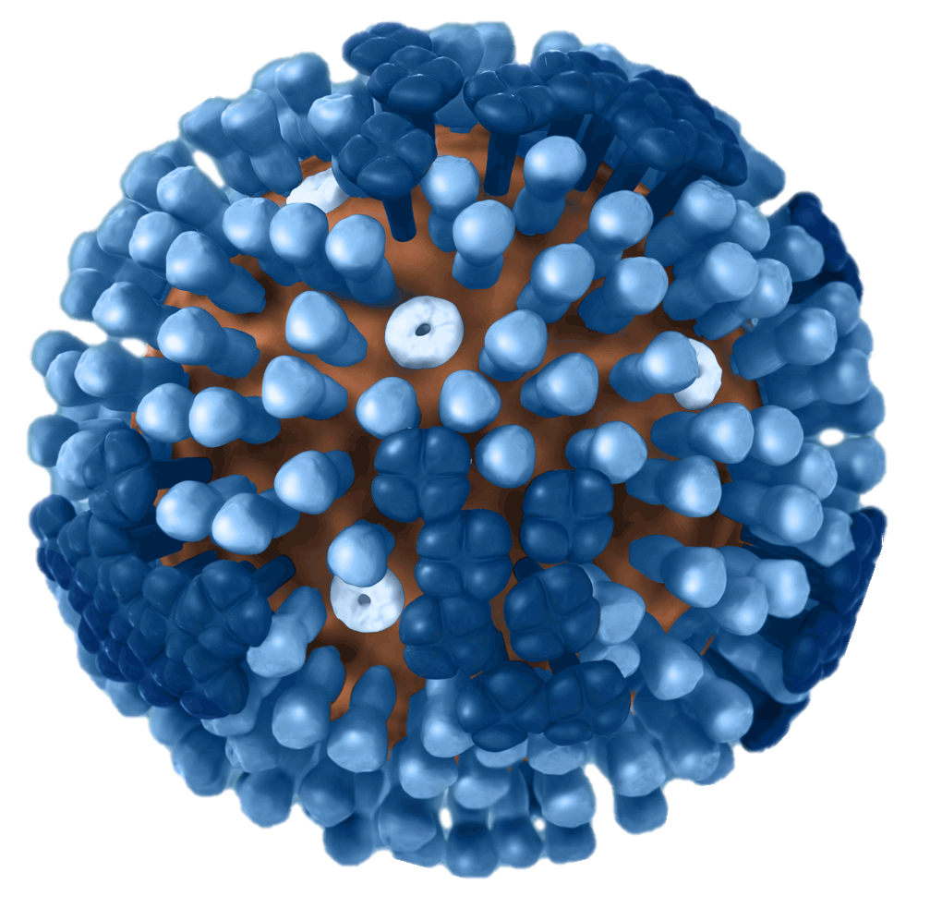
Case Definition
Animal Cases:
Ill swine: fever (106-108º F and a cough)
CONFIRMED: A positive RT-PCR influenza A test received from testing at the Moorefield Animal Diagnostic Laboratory and confirmed by the National Veterinary Services Laboratory.
Human Cases:
Acute respiratory illness after attending
the Jackson County Junior Fair.
Acute respiratory illness in a person with
an epidemiologic link to a confirmed case.
CONFIRMED: A positive RT-PCR influenza A test
using an assay capable of detecting novel influenza strains and
confirmed by the CDC.
Notes:
Swine cases were identified by the presence of fever and coughing. A confirmed swine case was a case that tested positive for influenza by PCR.
Human cases were identified based on clinical, epidemiologic and laboratory criteria. The clinical criteria included acute respiratory illness symptoms in a person that attended the Jackson County Junior Fair. Epidemiologic linkage was considered when a suspected case had contact with one or more confirmed case. Laboratory criteria for confirmation required the identification of an influenza A virus subtype that was different from the currently circulating human influenza H1 and H3 viruses. Influenza H3 subtypes originating from a non-human species is also considered a novel subtype.
Suspect cases of novel influenza were cases that met the clinical criteria and were pending laboratory confirmation. Confirmed cases had to meet laboratory criteria. All three human cases associated with this outbreak met confirmatory criteria.
ADDITIONAL NOTES:
Novel subtypes can be detected with methods available for detection of currently circulating human influenza viruses at state public health laboratories (e.g., real-time reverse transcriptase polymerase chain reaction [RT-PCR]). Confirmation that an influenza A virus represents a novel virus is completed by the CDC’s influenza laboratory.

Slide 6
Surveillance Methods
Local healthcare providers were asked to consider novel influenza infection in patients that reported acute respiratory illness after attendance at an agricultural event.
Healthcare providers were reminded to notify the LHD of any suspected novel influenza cases.
Swine influenza testing through the Moorefield Animal Diagnostic Laboratory and confirmatory testing at the National Veterinary Services Laboratory.
Testing through the WV OLS when suspected cases of novel influenza were reported to the LHD.
Confirmatory testing of novel influenza cases at the CDC laboratory when WV OLS testing results presumptive positive for novel influenza viruses.
A Health Advisory was distributed across the state to healthcare providers for situational awareness and to communicate recommendations for patients that report acute respiratory illness after attendance at an agricultural event.
Notes:
Cases were identified by local healthcare providers when patients experiencing acute respiratory illness reported attendance at the Jackson County Junior Fair.
Surveillance methods included notifying local health care providers to consider novel influenza infection in patients that reported acute respiratory illness after attending an agricultural event and reminding providers to report any suspected cases of novel influenza to their local health department. Ill swine were tested at the Moorefield Animal Diagnostic Laboratory and confirmation testing was completed at the National Veterinary Services Laboratory. Human testing for novel influenza was done at the West Virginia Office of Laboratory Services and confirmed by the CDC.
Finally, a Health Advisory was distributed across the state to healthcare providers in anticipation of the state fair and additional agricultural events across the state. The Health Advisory communicated recommendations for healthcare providers to follow for any patients that reported acute respiratory illness after attending an agricultural event.

Slide 7
Epidemiologic Data Overview
A total of three cases were confirmed to be infected with Influenza A(H3N2)v after attending the Jackson County Junior Fair.
All cases were under the age of 18.
Two of the three cases were hog exhibitors with access to the swine barn.
One case had no exposure to pigs and did not visit the swine barn.
Symptoms: Fever, cough, sore throat, large throat blisters, muscle aches, headache, shortness of breath, diarrhea, eye redness, rash, and fatigue.
None of the cases had any comorbidities or pre-existing medical conditions.
Two cases were prescribed antiviral medications.
No hospitalizations or deaths occurred.
One case had received their seasonal influenza vaccine for the current season.
Three household contacts reported symptoms but were not confirmed to have influenza and all recovered.
Notes:
A total of three cases were confirmed to be infected with Influenza A(H3N2)v after attending the Jackson County Junior Fair. All cases were under the age of 18 and attended the fair on multiple days. Two of the cases were swine exhibitors who had access to the swine barn and the third case had no exposure to pigs or the swine barn. The case’s symptoms included fever, cough, sore throat, large blisters in the throat, muscle aches, headache, shortness of breath, diarrhea, eye redness, rash, and fatigue. None of the cases had any comorbidities or pre-existing medical conditions. All cases were well enough to recover at home, there were no hospitalizations and no deaths. All cases were seen in an outpatient setting and two of the cases were prescribed the influenza antiviral Tamiflu. The two cases that took Tamiflu had an illness duration of 5 days and the case that did not take Tamiflu recovered after 11 days. Only one of the three cases had received their season influenza vaccine. Three household contacts that attended the fair also reported illness ranging from general malaise to vomiting, although none were confirmed to have influenza, and all recovered.

Slide 8
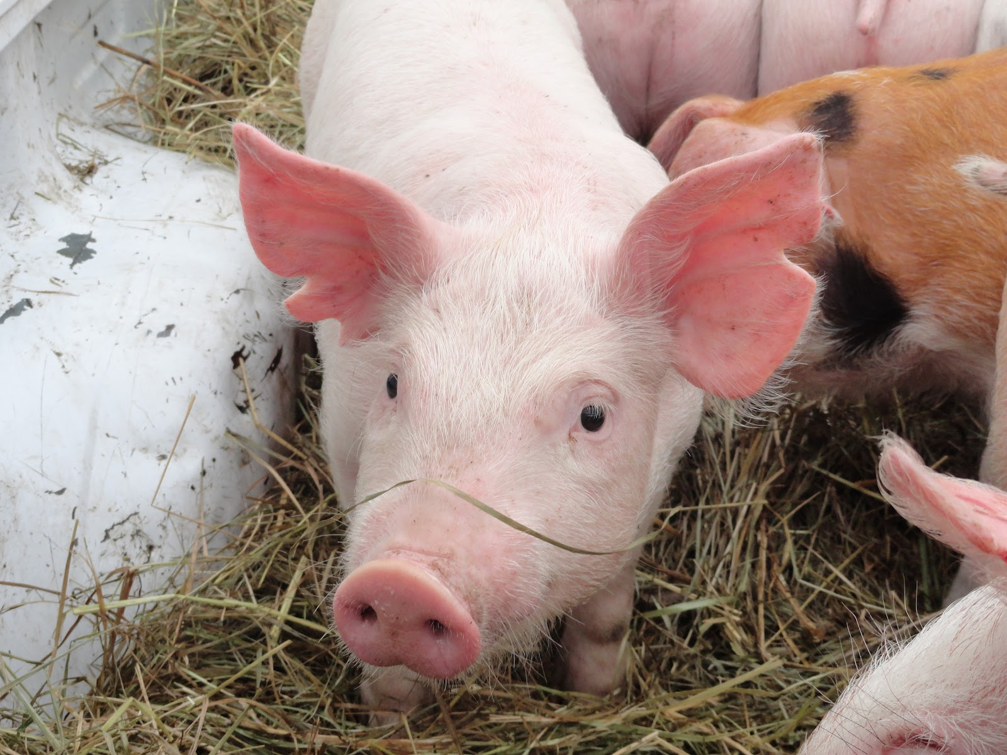
Public Health Recommendations
Cases and/or their guardians were educated on hand hygiene and respiratory etiquette.
Cases and/or their guardians were educated to avoid close contact with other people until being fever free for 24 hours without the use of fever reducing medication.
Cases and/or their guardians were educated to avoid contact with swine for days following symptom onset and until fever free for 24 hours without the use of fever reducing medication.
Contacts were educated to follow up with a healthcare provider should they develop symptoms.
Cases and/or their guardians were educated on the benefits of receiving an influenza vaccine annually.
This Photo by Unknown Author is licensed under CC BY-SA
Notes:
Public health recommendations included following proper hand hygiene and respiratory etiquette. Since all cases were under the age of 18 so recommendations were given to their legal guardians. The legal guardians were told to assist the cases with avoiding close contact with other people until being fever free for 24 hours without the use of fever reducing medication and to have the cases avoid contact with swine for 7 days following symptom onset and until fever free for 24 hours without the use of fever reducing medication. Contacts were recommended to monitor their health and follow up with a healthcare providers if they developed acute respiratory illness symptoms following contact with the case. And a general recommendation was made to receive the annual influenza vaccine annually (although the annual influenza vaccine is not considered to be preventative for novel strains of influenza.)

Slide 9
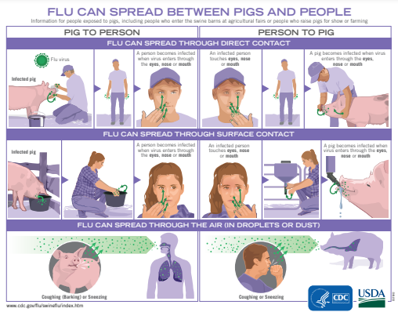
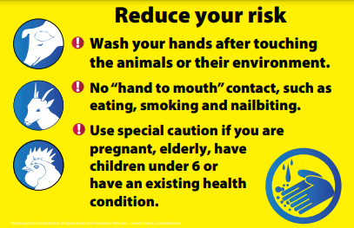
Public Health Recommendations (continued)
Recommendations to Fair Board:
Emphasize biosecurity during agriculture fair events.
Evaluate swine for illness as they arrive at an agricultural fair and immediately send ill swine home.
Close the swine barn to the public.
Post signage on preventing influenza transmission between pigs and people.
Notes:
Public health recommended that the Fair Board place emphasis on biosecurity measures at agricultural events, including evaluating swine for illness as they arrive and immediately sending ill swine home, to close the swine barn to the public and to educate fair goers on how to reduce the risk of transmitting influenza between animals and people.
Additional recommendations made by WVDA and the state veterinarian included sending ill swine home, condemning ill swine with fevers of 106 or greater to slaughter, and sampling ill swine for Swine Influenza testing.

Slide 10
Lessons Learned
The delay between identification of ill swine (first onset: 7/26/22) and closure of the swine barn (7/29/2022) could result in more additional exposures and/or repeated exposures of healthy swine and fairgoers. Added measures are needed to prevent delays in reporting ill swine to public health.
Case identification was based on physician report which may lead to underreporting for persons whose illness was mild and did not seek medical attention.
Notes:
At the start of this outbreak there was a delay between the initial identification of ill swine and notifying public health and agriculture agencies. This delay in notifications meant that appropriate recommendations were not made to the fair board until several days after the first ill swine was identified. This meant that healthy swine in the barn, fair goers or exhibitors that accessed the barn had more opportunities for exposure then they would have had if the recommendations had been made when illness was first identified. Recommendations for future fairs included immediately reporting illness in swine to appropriate agencies and as mentioned on prior slides focusing on biosecurity and educating the public on ways to prevent animal and human transmission of influenza.
The other consideration for this outbreak was that cases were identified through provider reports to public health which may result in underreporting among persons whose illness was mild and did not seek medical attention.

Slide 11
Successes
The rapid response from the Jackson County LHD lead to the quick identification of novel influenza cases and appropriate recommendations to cases and their families.
The WVDA staff were on-scene the same day illness in the swine barn was reported to the LHD. State veterinary staff collected specimens from the ill swine and ensured management of sick animals.
The WV OLS prioritized testing of suspected novel influenza cases with turn around times of less than 24 hours. Novel influenza specimens were promptly shipped to the CDC for confirmation.
Communication between state and local health, WV OLS, WVDA, and community healthcare providers facilitated the prompt and appropriate implementation of public health measures to prevent further potential exposures and reduce the risk of secondary spread.
Notes:
I want to take a moment here to acknowledge the successes achieved during this outbreak. All involved agencies were prompt in their response. The rapid response from the Jackson County LHD led to the quick identification of novel influenza cases and appropriate recommendations to the families of the cases. The staff at the Jackson County LHD did an exceptional job with case investigation and facilitating the testing of each case at the state lab, including driving the specimens down to expedite testing. The WVDA staff were on-scene the same day illness in the swine barn was reported to the LHD. State veterinary staff collected specimens from the ill swine and ensured appropriate management of sick animals. The WV OLS prioritized testing of suspected novel influenza cases with turn around times of less than 24 hours. Novel influenza specimens were promptly shipped to the CDC for confirmation. Communication between state and local health, WV OLS, WVDA, and community healthcare providers facilitated the prompt and appropriate implementation of public health measures to prevent further potential exposures and reduce the risk of secondary spread.

Slide 12
Summary and Conclusion
An outbreak of novel influenza, Influenza A(H3N2)v, occurred at the Jackson County Junior Fair in July 2022. An estimated 24,000-30,000 people attended the fair which included pig exhibits and an auction. Ill swine were reported to the LHD three days after the first pig became sick. Results from the National Veterinary Services Laboratory confirmed that ill pigs were infected with Influenza A(H3N2).
Three fairgoers were infected with Influenza A(H3N2)v. Two cases had direct exposure to sick pigs. All three were under the age of 18 and were able to recover at home. No secondary cases were identified.
The genomic sequence from the swine samples was a >99.9% match to the influenza virus sequence taken from the human cases.
Notes:
To summarize: An outbreak of novel influenza, Influenza A(H3N2)v, occurred at the Jackson County Junior Fair in July 2022. An estimated 24,000-30,000 people attended the fair which included pig exhibits and an auction but it is unknown how many people accessed the swine barn or were exposed to the infected swine. Ill swine were reported to the LHD three days after the first pig became sick. A total of three human cases were identified, all were under the age of 18 and were able to recover at home. There were no secondary cases. Results from swine and human confirmed that the same Influenza A(H3N2) virus was infecting both the swine and human cases associated with the outbreak with a >99.9% identity match between the viral sequences taken from swine and human specimens.

Slide 13
Sentinel Provider Recruitment, 2023-2024
Sentinel provider recruitment will start on July 10, 2023.
NEW FOCUS: Recruitment of hospitals as sentinel providers in counties that are unable to secure an outpatient provider’s participation.
When recruiting providers that have NOT previously participated in ILINet, please keep in mind:
Large providers that see more than 500 patients a week must submit data for validation before the deadline in September.
There is no enrollment deadline or data validation process for providers that see fewer than 500 patients a week.
Providers that have participated in ILINet during the current or past seasons do not have a data validation requirement although they still need to declare their intention to participate in the 2023-2024 season or their ILINet accounts will be deactivated.
LHDs are encouraged to complete the recruitment process early to ensure that sentinel providers can take advantage of the incentives being offered.
Notes:
Lastly, I wanted to take a moment to mention a few updates for Sentinel Provider Recruitment for the ILINet Program this upcoming season. Sentinel provider recruitment will start earlier this year to make sure there is enough time for newly participating providers to go through the data validation process if needed. Materials for Sentinel Provider Recruitment will be distributed by email to Regional Epidemiologists and LHDs before the recruitment period is opened. There will be a new focus on recruiting hospitals in the areas that have had difficulty securing an outpatient provider’s participation this season. Providers that participated in 2022-2023, will receive a survey asking about their experience as a sentinel provider and gauging their interest in participation for the upcoming season. Local health departments will be notified with the results of these surveys prior to the start of the recruitment period to guide their outreach activities. There are a few considerations to keep in mind when recruiting new providers to participate in ILINet. New providers that have never participated in ILINet before will need to go through a data validation process if their practice sees more than 500 patients per week. The CDC sets a firm deadline in September for all data to be submitted, as it may take a few weeks for the CDC to provide feedback and the site to make any necessary adjustments. The goal is to ensure that all providers are prepared to begin submitting reports by the first week of the upcoming influenza season which is always MMWR week 40. Providers that are unable to submit data for validation by the deadline will have to wait until the following year’s enrollment period opens to participate. The validation process ensures that the healthcare provider’s reports are timely, complete and accurate; and is necessary considering that large providers have the potential to skew the entire state’s ILI data indicators. There is no enrollment deadline or data validation required for newly participating sentinel providers whose practice sees less than 500 patients per week. Providers that have participated in ILINet during the current or past seasons do not have a data validation requirement although they still need to declare their intention to participate in ILINet for 2023-2024 by September 23, 2023 or their ILINet accounts will be deactivated.

Slide 14
Contact Information
Jillian Wall, MPH
Respiratory Disease Epidemiologist,
Influenza Surveillance Coordinator
West Virginia Department of Health and Human Resources
Bureau for Public Health
Office of Epidemiology and Prevention Services
Division of Infectious Disease Epidemiology
350 Capitol Street, Room 125
Charleston, WV 25301
Phone: (304) 352-6217
Fax: (304) 558-8736
Email: Jillian.L.Wall@wv.gov
Website: oeps.wv.gov/flu/pages/default.aspx

