Slide 1


Calculating Timeliness in
West Virginia Electronic Disease Surveillance System (WVEDSS)
December, 2025

Slide 2
Evaluating Timeliness
Background
Importance of timeliness in disease surveillance
Timeliness fields
Data dictionary
Pulling West Virginia Electronic Disease Surveillance System (WVEDSS) data for timeliness

Slide 3
Background
Timely notification and response to infectious diseases is critical for prompt response by public health.
A case investigation created in WVEDSS serves as notification to the local health department (LHD) of the case as it will not appear in their “Open Cases Queue”
The recommended time frame of reporting from WVEDSS to CDC Nationally Notifiable Diseases Surveillance System (NNDSS) is 30 days.
LHDs should prioritize investigating patients within timelines that correspond with preventing further disease transmission and/or allow post exposure prophylaxis when indicated. Cases awaiting additional information such as confirmatory testing or atypical cases requiring complex public health guidance may need to remain open in WVEDSS.
For reportable conditions, it is best practice that the LHD complete and submit case investigations to the Regional Epidemiologist for review within two weeks of receipt and no later than thirty days after initial notification. Case investigations older than thirty days may be administratively closed.

Slide 4





Importance of Timeliness in Disease Surveillance
Receipt of Positive Lab of a Reportable Disease
Local Health Department Case Investigation
Regional Epidemiologist Case Review
State Health Department Case Review
Submission of Case Data to the CDC
>1 day
2 weeks
1 week
1 week
Why is timeliness critical ?
Preventing Larger Outbreaks:
Early detection and prompt investigation help to prevent many illnesses from occurring.
Identifying the Source:
Timely investigation is necessary to identify the source and risk factors of an outbreak, allowing for effective and early intervention for possible contacts.
Protecting Public Health:
Swift action ensures that the appropriate control measures are put in place to protect the public's health.

Slide 5
Timeliness Fields
 |  | State Health Dept. Level | Local / Regional Investigation Level | State Health Dept. Review | Total Time Elapsed
Disease (Case Count) | Program Area | Date Lab Received to Case Investigation Creation Date | Investigation Creation Date (Local Level) to Submission to the RE | RE Review to State Review /CDC notification | Total Time elapsed
 | WVEDSS Fields Used | (PHC Add Time) – (EARLIEST_LAB_ADD_DATE) | (First Notification Sent Date - Phc Add Time) | (Last Notification Date - First Notification Date) | (Last Notification Date–(EARLIEST_LAB_ADD_DATE)
Hep A Acute (5 Cases) | HEP | >1 day | 20 days | 7 days | 28 days
Notes:
Data Modernization Initiative (DMI)
https://www.cdc.gov/data-modernization/php/about/dmi.html

Slide 6
Data Dictionary
 | WVEDSS Report Column Name | Variable | Detailed explanation
Date a Lab was added to WVEDSS | EARLIEST_LAB_ADD_DATE | Date (01/01/2025) | The date the lab report was added to WVEDSS
Public Health Case Add Time | PHC Add Time | Date (01/01/2025) | The date the case investigation was created in WVEDSS
Investigation Start Date | Inv_Start Date | Date (01/01/2025) | The date the case investigation was started
First Notification Sent Date | First_Notification_Sent_Date | Date (01/01/2025) | The date the Regional epidemiologist sent the case for state review
Last Notification Sent Date | Last_Notification_Sent_Date | Date (01/01/2025) | The date the Department of Health sent the case notification to the CDC

Slide 7
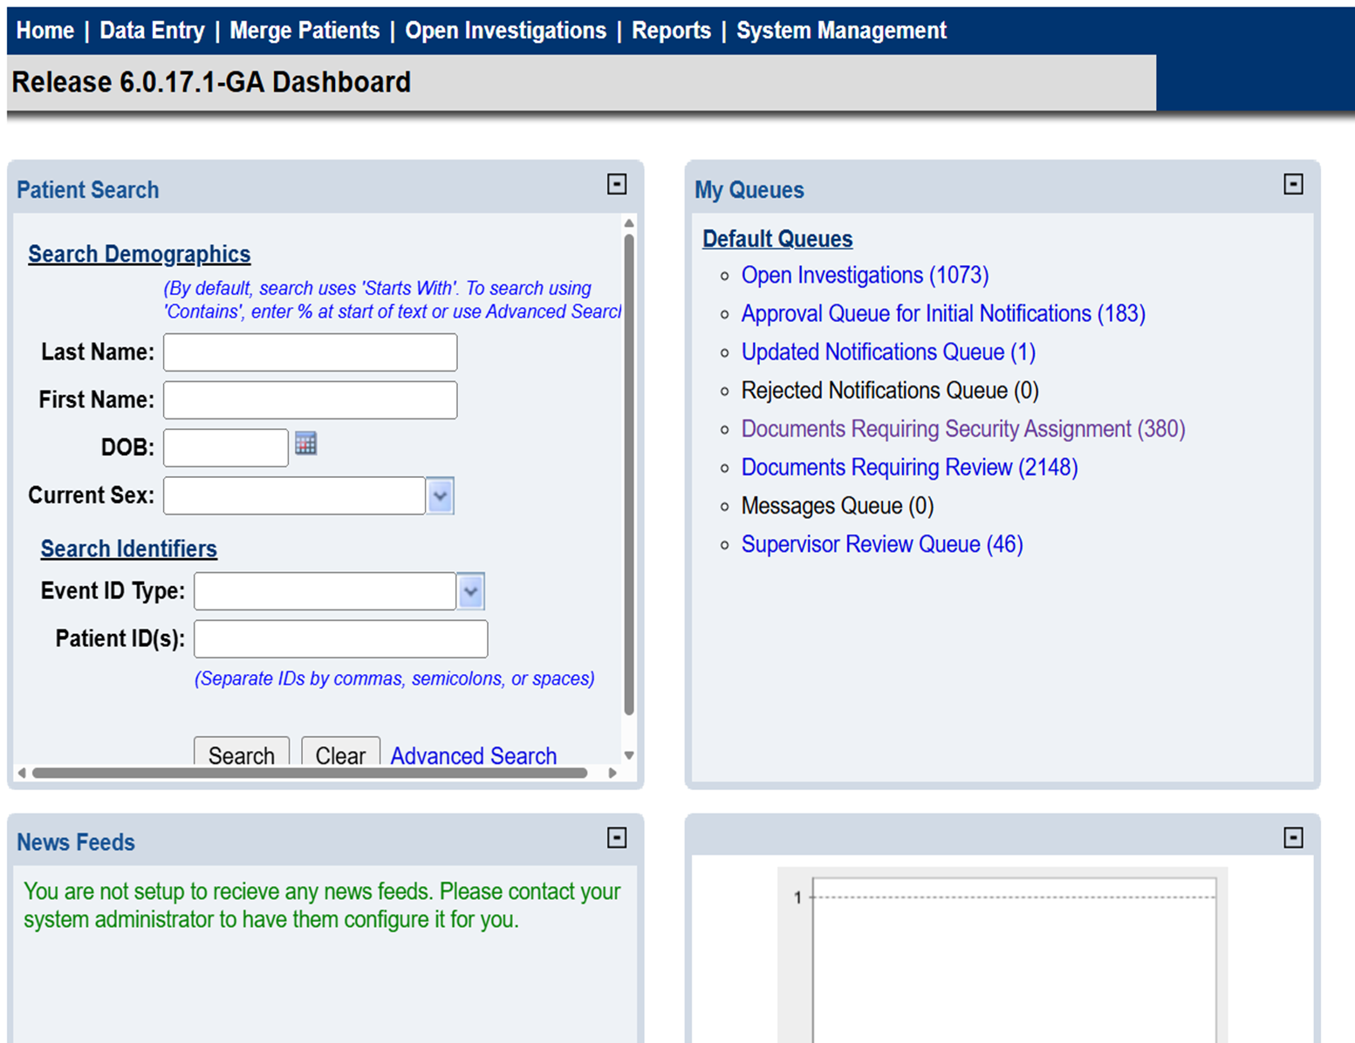
How to run a Timeliness Report
Navigate to the Reports Menu at the top of the WVEDSS Home Screen
Notes:
eCR in Action - https://www.cdc.gov/ecr/php/stories/index.html

Slide 8
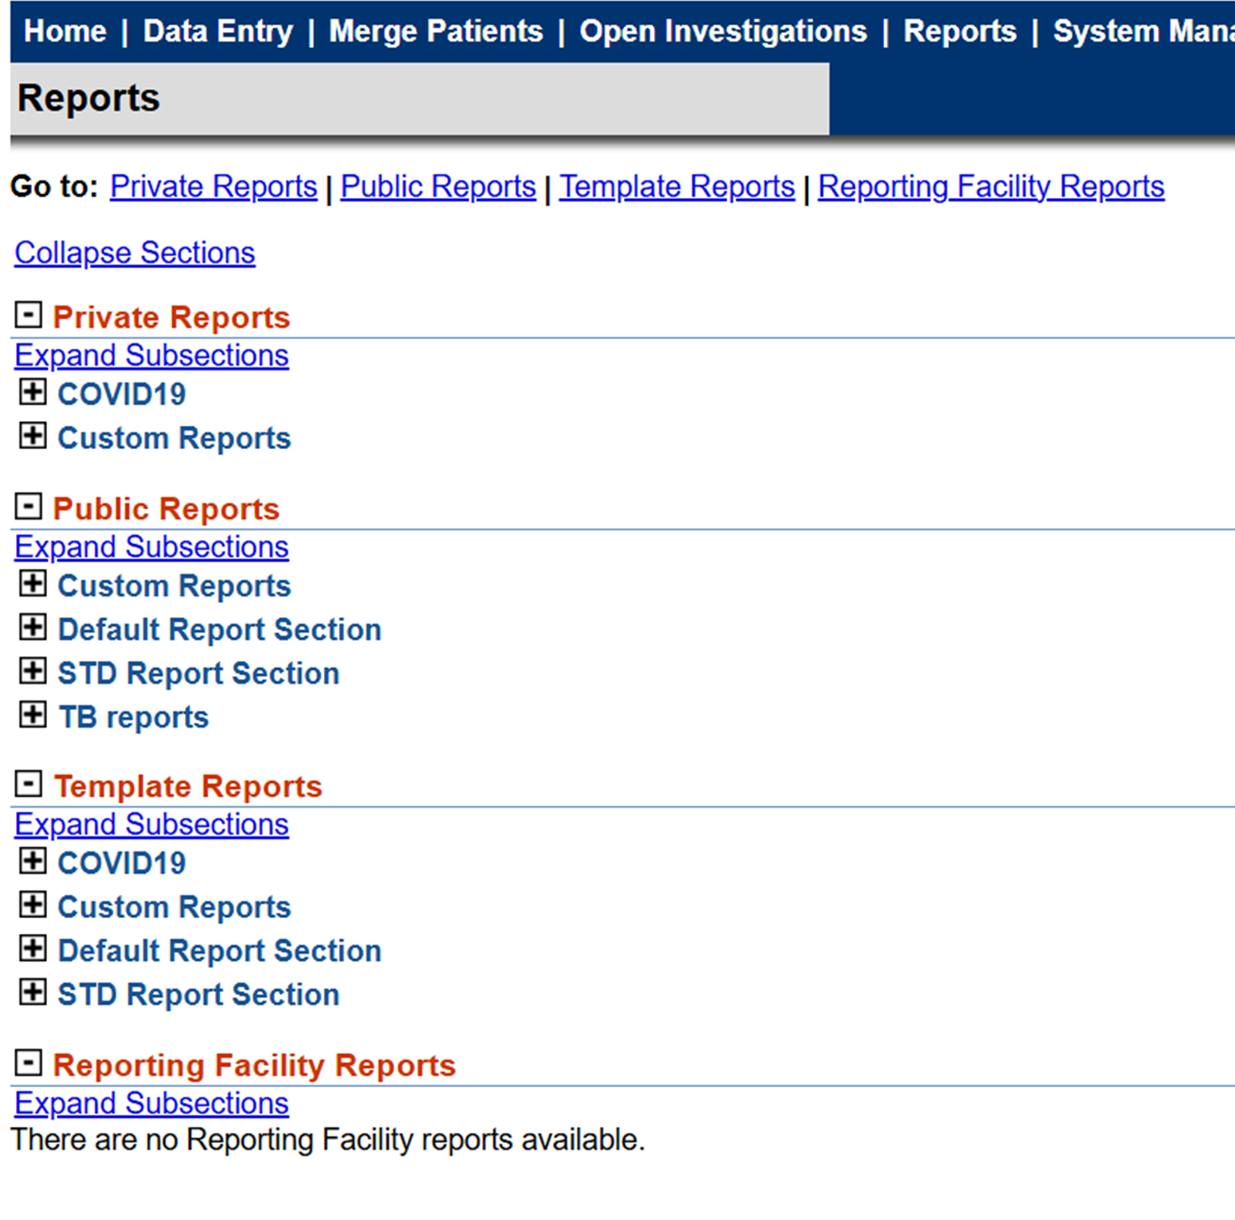
How to run a Timeliness Report
Click to expand Default Report Section
Notes:
eCR in Action - https://www.cdc.gov/ecr/php/stories/index.html

Slide 9
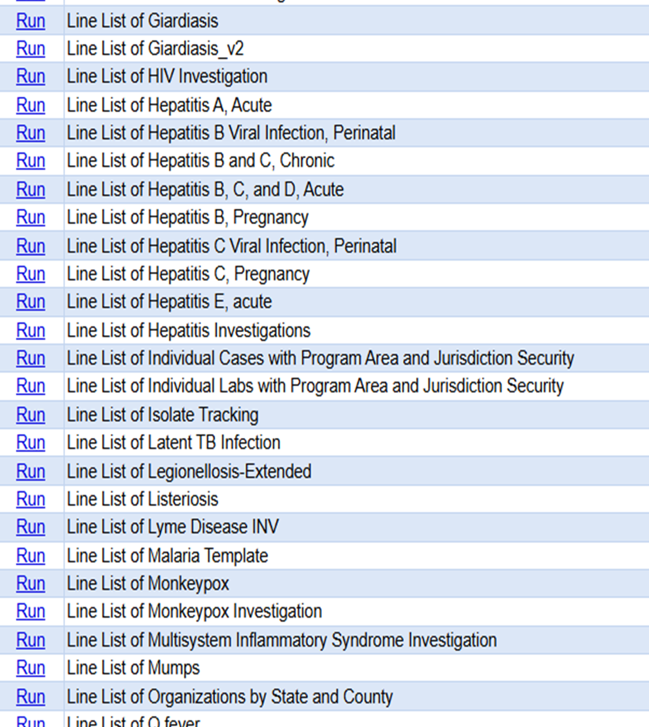
How to run a Timeliness Report
Select Run “Line List of Individual Cases with Program Area and Jurisdiction Security”
Notes:
eCR in Action - https://www.cdc.gov/ecr/php/stories/index.html

Slide 10
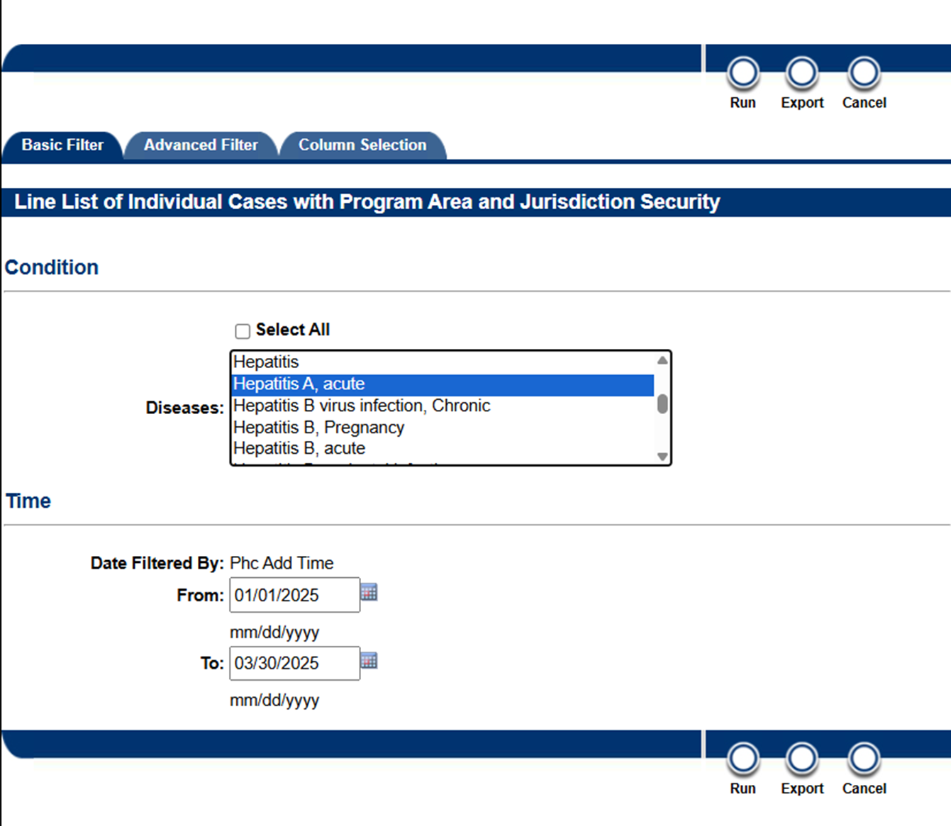
How to run a Timeliness Report
Select the disease(s) needed for your report from the “Conditions” listing.
Enter the date frames for the cases you will be evaluating under “Time”.
Notes:
eCR in Action - https://www.cdc.gov/ecr/php/stories/index.html

Slide 11
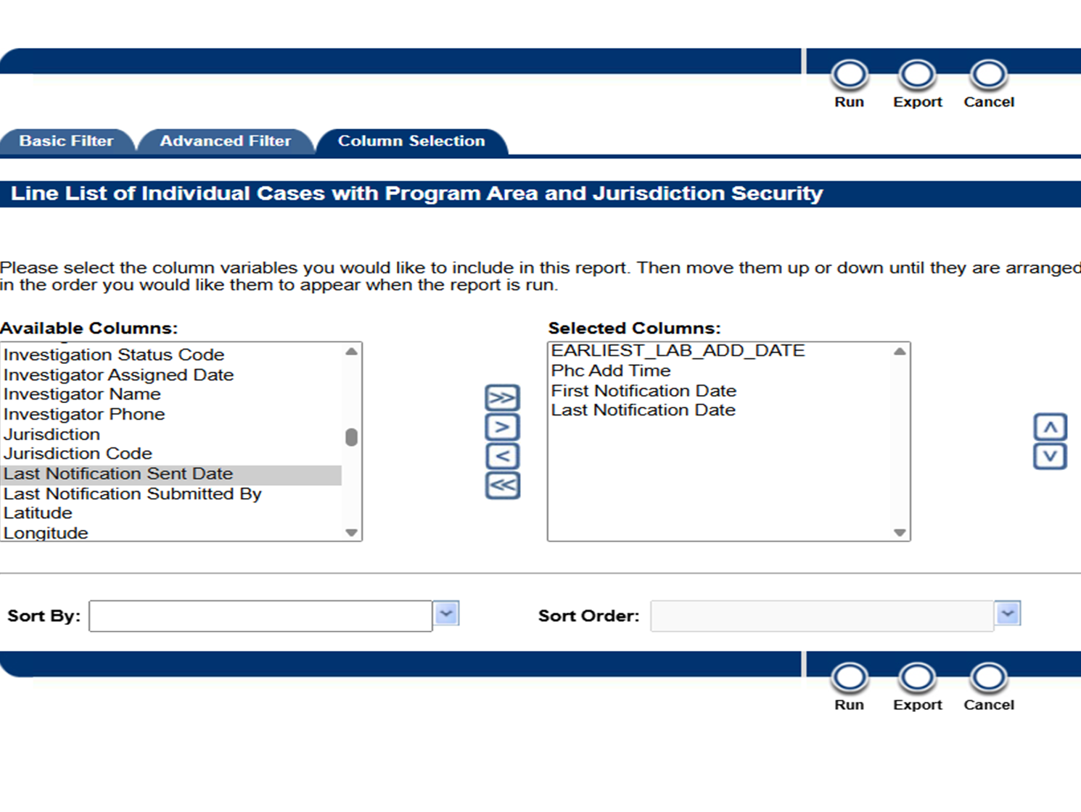
How to run a Timeliness Report
Select “Column Selection.”
Select the following fields:
  EARLIEST_LAB_ADD_DATE
  Phc Add Time
  First Notification Date
  Last Notification Date
Select “Export”
*Additional fields may be selected for analysis, but the columns listed are the minimum data necessary for timeliness calculations.
Notes:
eCR in Action - https://www.cdc.gov/ecr/php/stories/index.html

Slide 12
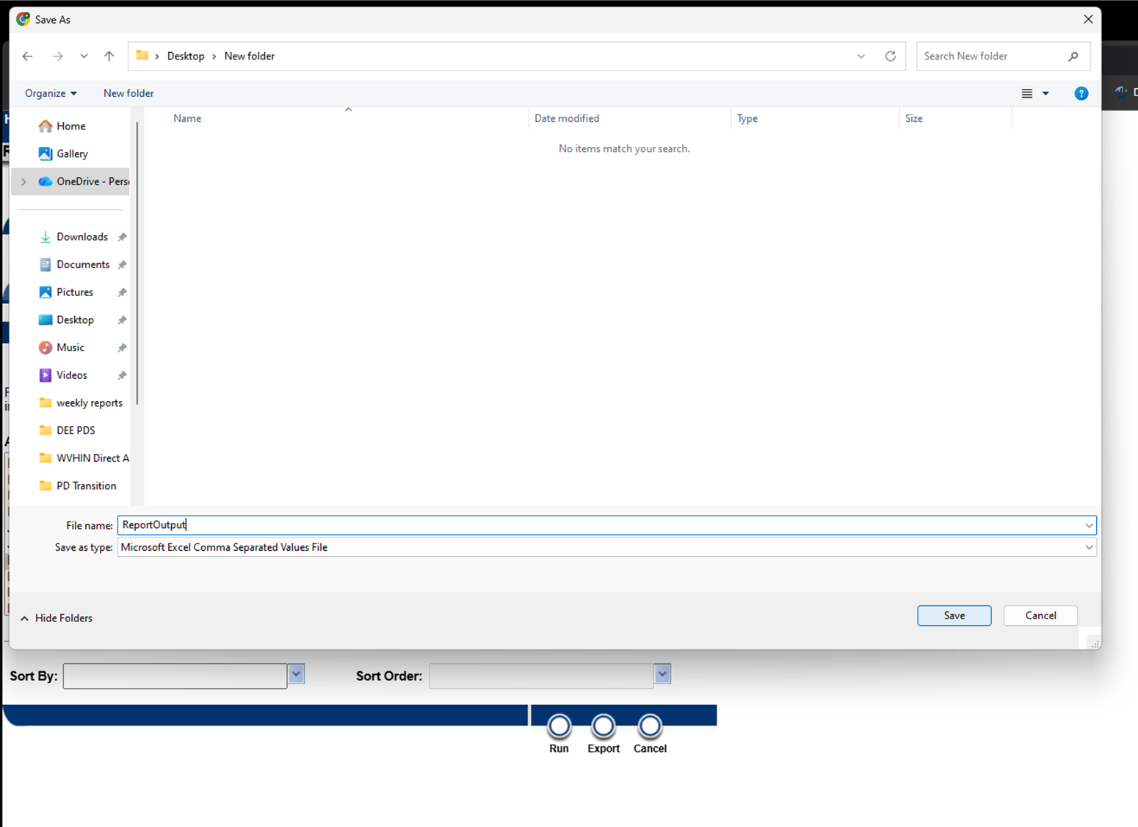
How to run a Timeliness Report
Save the report to a folder that you can easily locate the file.
Notes:
eCR in Action - https://www.cdc.gov/ecr/php/stories/index.html

Slide 13
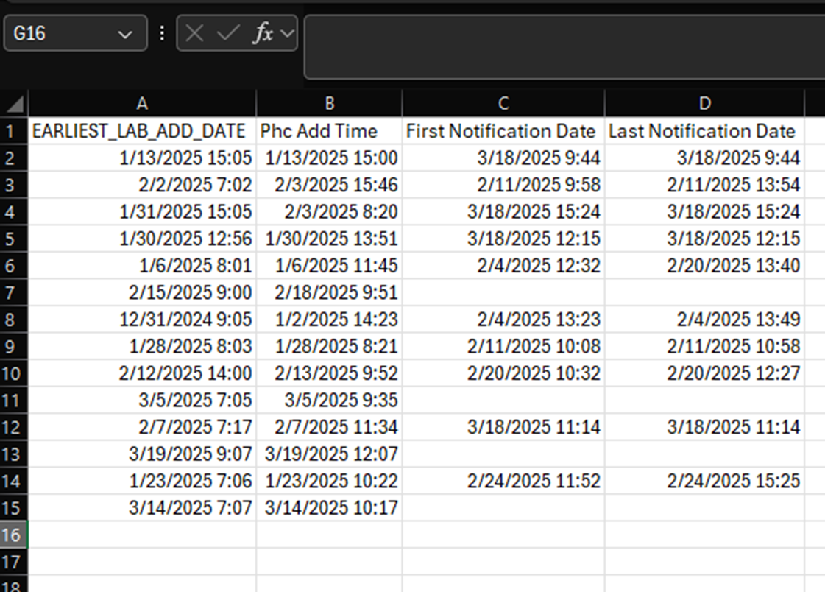
How to run a Timeliness Report
Navigate to where you saved the export.
Utilize Excel or another comparable application for analysis to compare the dates of submission.
Example: Total Elapsed Case Investigation Time:
(=D2-A2)
*Blank or missing values may signify a case is still in progress and has not yet been submitted for review.

Slide 14
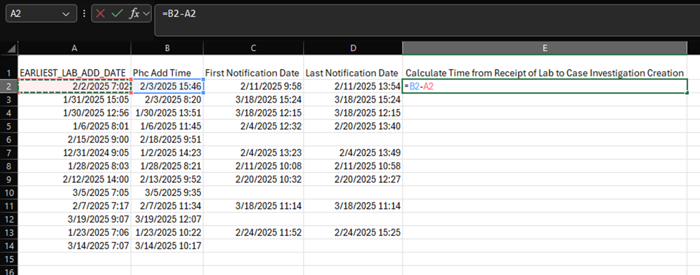
How to run a Timeliness Report
To calculate the amount of time from receipt of the laboratory report to creation of a case investigation, subtract the (Phc Add Time) from the (EARLIEST_LAB_ADD_DATE) , In Excel, in an empty column enter “=B2-A2” and press “Enter.”
*Excel column and row letters and numbers may change based on the number of fields pulled from your WVEDSS export.

Slide 15
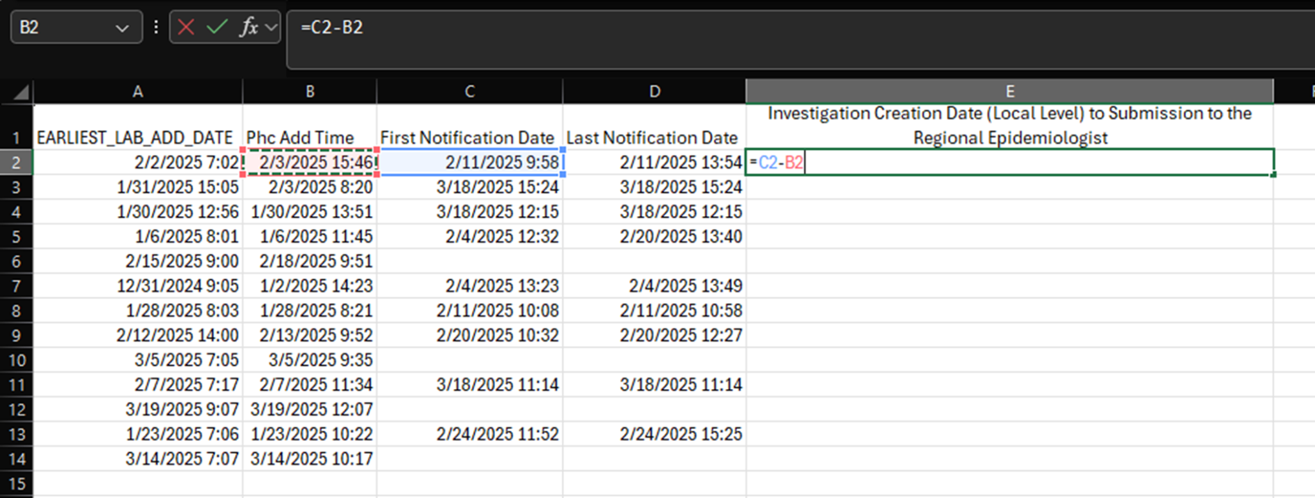
How to run a Timeliness Report
How to run a Timeliness Report
To calculate the amount of time from Investigation Creation Date (Local Level) to Submission to the Regional Epidemiologist, subtract the (Phc Add Time) from (First Notification Date), In Excel, in an empty column enter “=C2-B2” and press “Enter.”
*Excel column and row letters and numbers may change based on the number of fields pulled from your WVEDSS export.

Slide 16
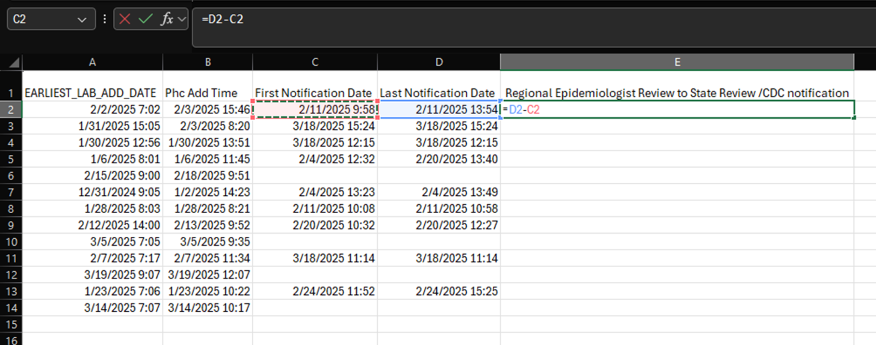
How to run a Timeliness Report
To calculate the amount of time from Regional Epidemiologist Review to State Review /CDC notification, subtract the (First Notification Date) from (Last Notification Date), In Excel, in an empty column enter “=D2-C2” and press “Enter.”
*Excel column and row letters and numbers may change based on the number of fields pulled from your WVEDSS export.

Slide 17
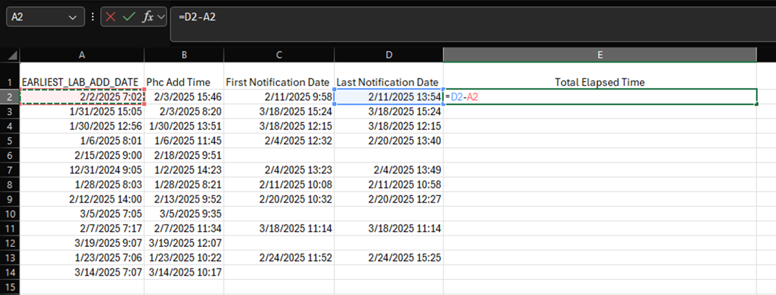
How to run a Timeliness Report
To calculate the total elapsed time of a case investigation from start to finish, subtract the (Last Notification Date) from (EARLIEST_LAB_ADD_DATE), In Excel, in an empty column enter “=D2-A2” and press “Enter.”
*Excel column and row letters and numbers may change based on the number of fields pulled from your WVEDSS export.

Slide 18
Things to Remember
Blank fields may be contributed to an open case investigation that is still in progress, this analysis is most useful on completed investigations.
During your analysis you may encounter negative days calculated. This can be attributed to a case investigation created before the receipt of a lab report. Example – A provider calls in a suspect case to the Local Health Department while awaiting testing confirmation.
Not all fields may be available for analysis, for example when a Regional Epidemiologist position is vacant, notifications bypass the Regional level and go straight to the State Department of Health.
This analysis can provide a basis to understanding the range of timeliness during the case investigation process but is not comprehensive.
If you need any assistance duplicating this analysis please contact oepsdatasystems@wv.gov

